Slide 1
On-Shell Methods in Quantum Field Theory
David A. Kosower Institut de Physique Théorique, CEA–Saclay
LHC PhenoNet Summer School Cracow, Poland September 7–12, 2013

Slide 2
Review of Lecture II
Used factorization to derive BCFW on-shell recursion relations
Used unitarity to obtain a basic formula

Slide 3
First Steps
Compute tree amplitudes: using Berends–Giele recursion, BCFW, Grassmannians, etc.
Form phase-space integral
Promote it back to a loop integral
This has the correct cut in the K² channel, not necessarily in other channels
Do algebra to simplify numerator, and perform integral reductions

Slide 4
Problems
Diagram-by-Diagram
Massive particles: massless particles have divergences
Absorptive (imaginary) parts only
An amplitude has many channels; here we handle only one

Slide 5
Next Steps
Identify Feynman integrals, and replace four-dimensional forms by dimensionally-regulated integrals
Retain only integrals which have a cut in the current channel K²
“Sum” over channels: when encountering the same integral more than once, retain only one copy
Need additional techniques for terms with no cuts
Version 1 of the unitarity method; used for many calculations in the 1990s

Slide 6
Problems
Diagram-by-Diagram
Massive particles: massless particles have divergences
Absorptive (imaginary) parts only
An amplitude has many channels; here we handle only one
Reduction algebra left to do: can’t implement this purely numerically
not an obstruction to analytic calculations

Slide 7
On-Shell Methods
Formalism
Rational function of spinors
Known integral basis:
On-shell Recursion; D-dimensional unitarity via ∫ mass
Unitarity in D = 4

Slide 8
On-Shell Methods
Kinematics: spinor variables
Properties of amplitudes become calculational tools
Factorization → on-shell recursion (Britto, Cachazo, Feng, Witten)
Unitarity → unitarity method (Bern, Dixon, Dunbar, DAK,…)
Basic Unitarity
Generalized Unitarity
Underlying field theory → integral basis

Slide 9
One-Loop Integrals
What integrals can arise?
In an n-gluon amplitude, we get integrals with up to n propagators; and up to n powers of the loop momentum (one at each three-vertex)
[In an n-graviton amplitude, we get integrals with up to n propagators; and up to 2n powers of the loop momentum (two at each three-vertex)]
Contracted into external vectors: momenta, polarization vectors, spinor strings

Slide 10
One-Loop Integrals
Need to compute
In principle, can just do the integral:
Feynman-parametrize
Perform loop integral
Perform Feynman parameter integrals
expression in terms of logarithms & dilogarithms
But analysis is hard; algebra is easy

Slide 11
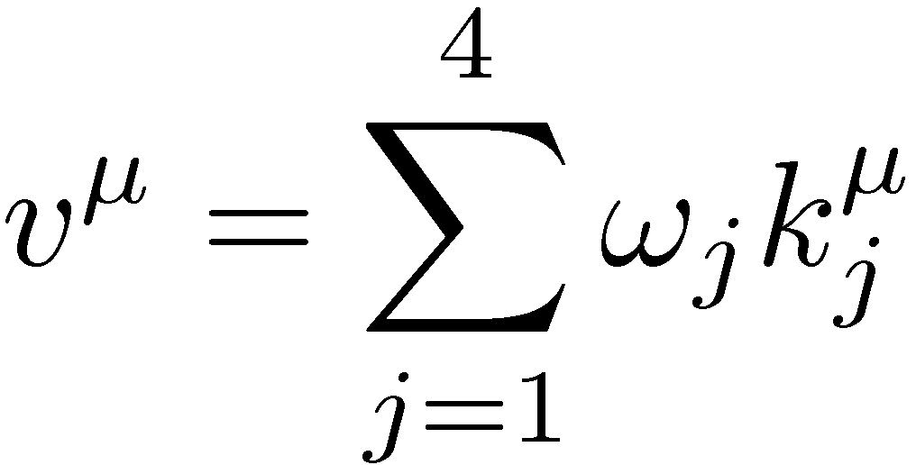
Want to eliminate analysis in favor of algebra: exploit algebraic relations between integrals
Example: tensor reduction
External vectors are taken to be four-dimensional
n-point rank-j integral ⇒ (n−1)-point rank-(j−1) integral ⊕ n-point rank-(j−1) integral

Slide 12
Define Gram determinant
In D = 4, any five vectors are linearly dependent
equation relating I₆ to a linear combination of I₅s, etc.
equation relating I₅ to a linear combination of I₄s + O(ε)

Slide 13
Combining all possible equations, we get additional equations that allow us to express
n≥6-point integrals in terms of boxes and pentagons, to all orders in ε
n≥5-point integrals in terms of boxes, through order ε⁰
Eliminate all tensor integrals in favor of scalar ones
Use Lorentz invariance & parity to reduce four- and lower-point tensor integrals
Get a limited basis
At higher loops, add ‘integration-by-parts’ (IBP) identities

Slide 14
Integral Basis
At one loop, all n≥5-point amplitudes in a massless theory can be written in terms of nine different types of scalar integrals:
boxes (one-mass, ‘easy’ two-mass, ‘hard’ two-mass, three-mass, and four-mass);
triangles (one-mass, two-mass, and three-mass);
bubbles
In an N =4 supersymmetric theory, only boxes are needed.

Slide 16
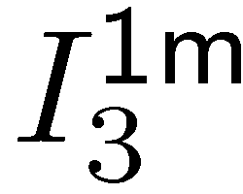
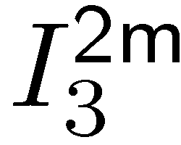
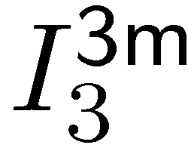
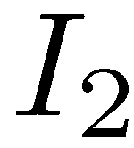

Slide 17
The Three Roles of Dimensional Regularization
Ultraviolet regulator;
Infrared regulator;
Handle on rational terms.
Dimensional regularization effectively removes the ultraviolet divergence, rendering integrals convergent, and so removing the need for a subtraction in the dispersion relation
Pedestrian viewpoint: dimensionally, there is always a factor of (–s)^{–ε}, so at higher order in ε, even rational terms will have a factor of ln(–s), which has a discontinuity

Slide 18
Generalized Unitarity
Unitarity picks out contributions with two specified propagators
Can we pick out contributions with more than two specified propagators?
Yes — cut more lines
Isolates smaller set of integrals: only integrals with propagators corresponding to cuts will show up
Triple cut — no bubbles, one triangle, smaller set of boxes

Slide 19
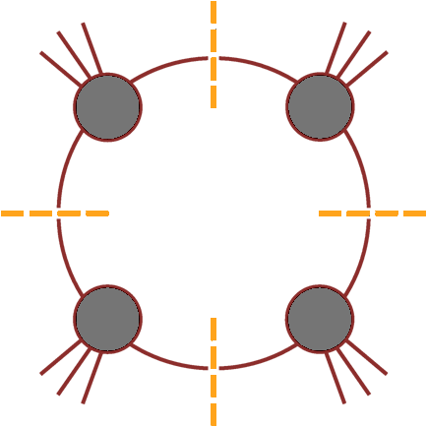
Can we isolate a single integral?
D = 4 → loop momentum has four components
Cut four specified propagators (quadruple cut) would isolate a single box

Slide 20
Quadruple Cuts
Work in D=4 for the algebra
Four degrees of freedom & four delta functions
… but are there any solutions?

Slide 21
A Subtlety
The delta functions instruct us to solve
1 quadratic, 3 linear equations ⇒ 2 solutions
If k₁ and k₄ are massless, we can write down the solutions explicitly
solves eqs 1,2,4;
Impose 3rd to find
or

Slide 22
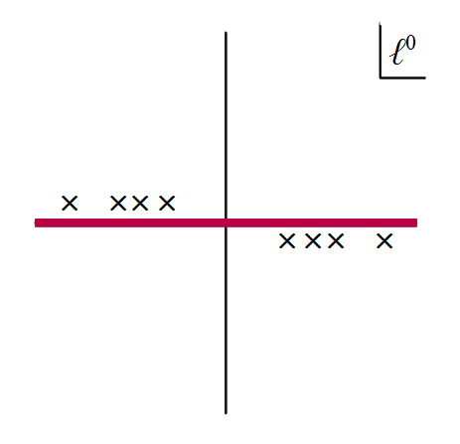
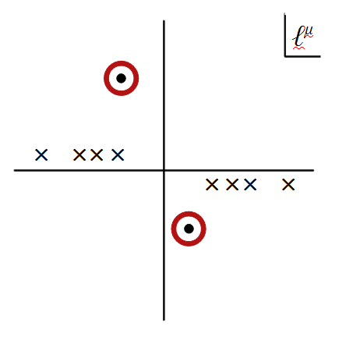
Solutions are complex
The delta functions would actually give zero!
Need to reinterpret delta functions as contour integrals around a global pole [other contexts: Vergu; Roiban, Spradlin, Volovich; Mason & Skinner]
Reinterpret cutting as contour modification

Slide 23
Global poles: simultaneous on-shell solutions of all propagators & perhaps additional equations
Multivariate complex contour integration: in general, contours are tori
For one-loop box, contours are T⁴ encircling global poles

Slide 24
Two Problems
Too many contours (2) for one integral: how should we choose the contour we use?
Changing the contour can break equations:
is no longer true if we modify the real contour to circle only one of the poles
Remarkably, these two problems cancel each other out

Slide 25
Require vanishing Feynman integrals to continue vanishing on cuts
General contour
⇒ $a_{1}=a_{2}$

Slide 26
Box Coefficient
A
B
Go back to master equation
Apply quadruple cuts to both sides
Solve:
Britto, Cachazo, Feng
No algebraic reductions needed: suitable for pure numerics
D
C

Slide 27
Problems
Diagram-by-Diagram
Massive particles: massless particles have divergences
Absorptive (imaginary) parts only
An amplitude has many channels; here we handle only one
Reduction algebra left to do: can’t implement this purely numerically

Slide 28
Color Ordering at One Loop
For adjoints
A_{n;c} can be written as a sum of permutations of A_{n;1}

Slide 29
Approaches to One-Loop Amplitudes
Generalized Unitarity
General theories using on-shell methods
Integrand Level: Ossola–Papadopoulos–Pittau method
⇒ Costas Papadopoulos’s lectures
Integral Level:

Slide 30
Three-Point Amplitudes
Two non-vanishing helicity configurations,
and two vanishing ones,

Slide 31
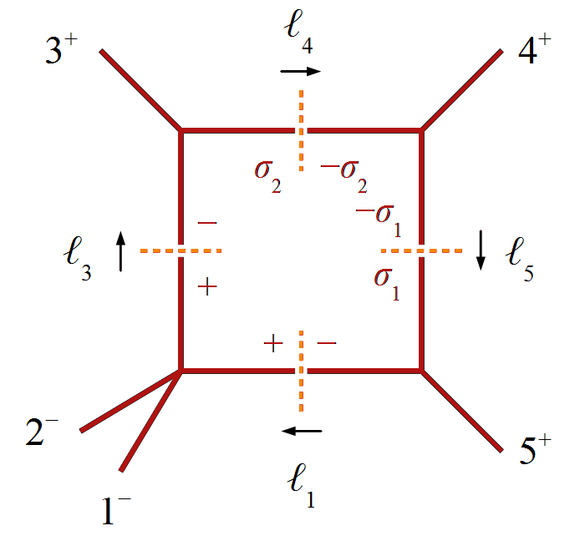
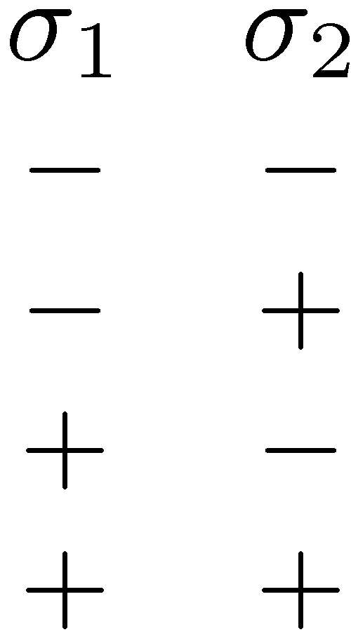
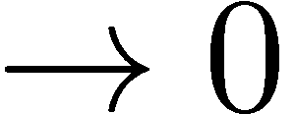
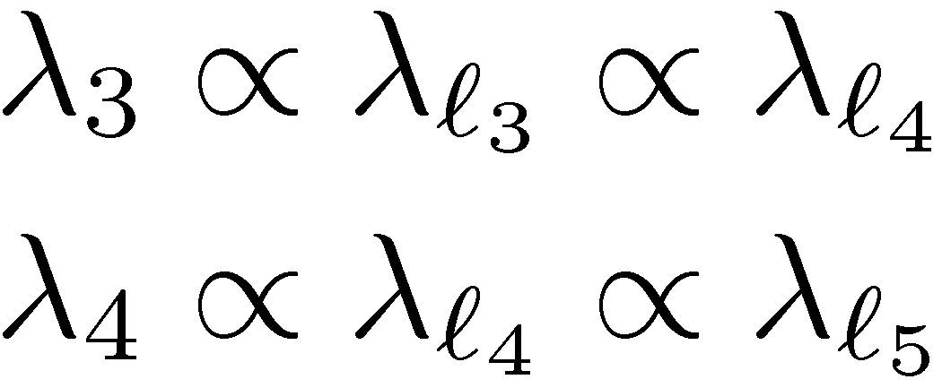
Example 1: coefficient of I₄(K₁₂,3,4,5) in A₅(1⁻,2⁻,3⁺,4⁺,5⁺)
Look at the quadruple cut
+++ vertex
to be non-vanishing, need
but in general, so one will vanish
General feature: opposite-chirality three-point vertices alternate

Slide 32
Take :
then
impose
then

Slide 33
Use the quadruple-cut formula

Slide 34
Same as coefficient in N = 4 SUSY!

Slide 35
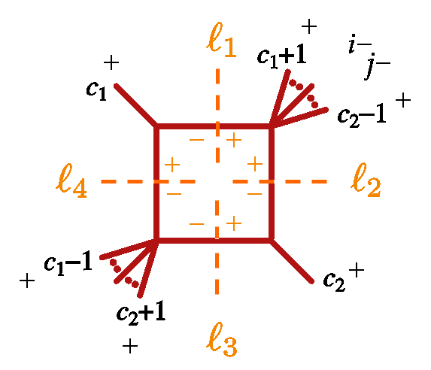
Example 2: All-n MHV
Coefficient of a specific easy two-mass box: only one solution will contribute

Slide 36
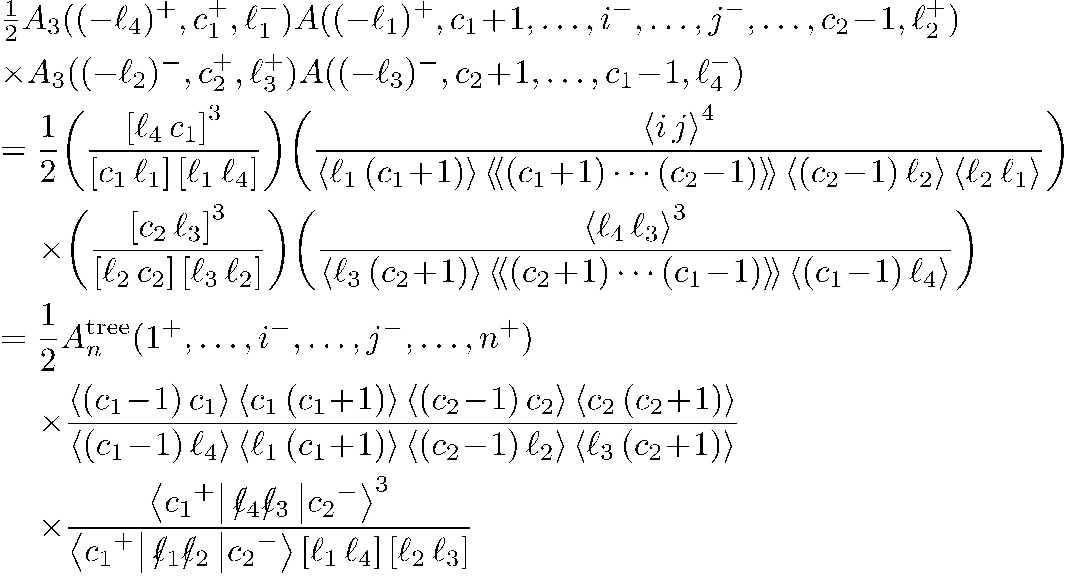

Slide 37
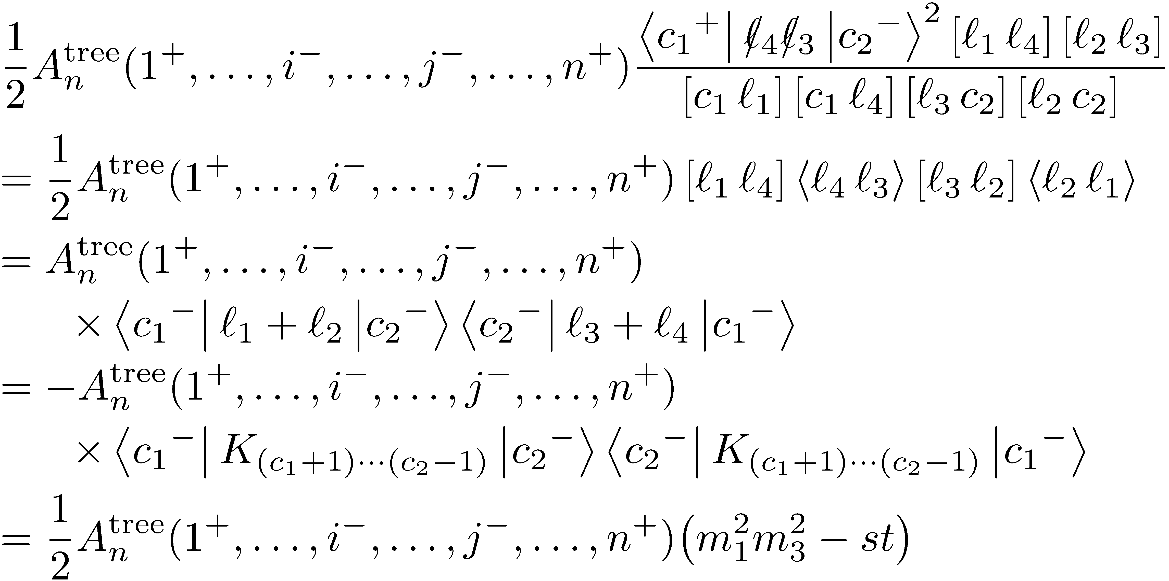
Using momentum conservation
our expression becomes

Slide 38
In N = 4 SUSY, this is the complete answer!

Slide 39
Triangle Cuts
Unitarity leaves one degree of freedom in triangle integrals.
Coefficients are the residues at ∞ Forde (2007)
2
1
3

Slide 40
Some boxes will share the same three propagators
But of course have an additional propagator
⇒ other poles in the complex plane
These terms scale as 1/t as t → ∞

Slide 41
Define an operator Inf_{t} extracting the pole-free parts wrt t
Its $t=0$ term gives the residue at infinity
The cut integrand has the form
To extract it:
triangle
boxes

Slide 42
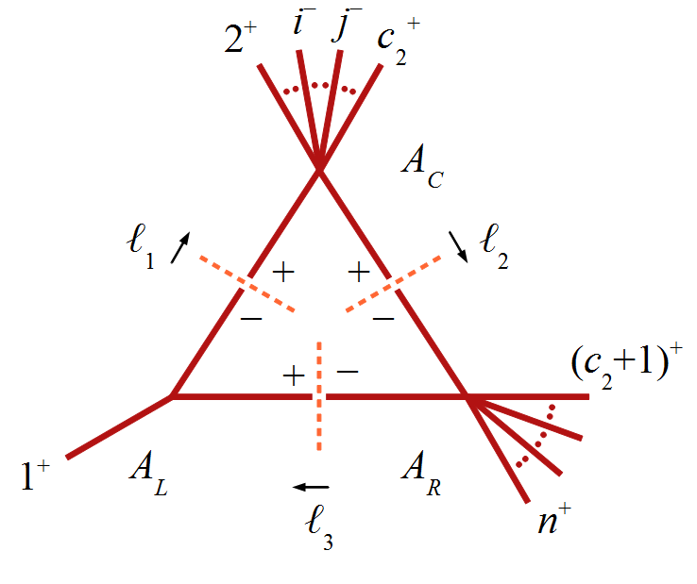
Example 3: All-n MHV
Compute coefficient of two-mass triangle in QCD or N = 4 SUSY
First compute
Determine the spinors,

Slide 43
Now
so
Also
so
and
so
and

Slide 44
Back to Integrals
and their singularities

Slide 45
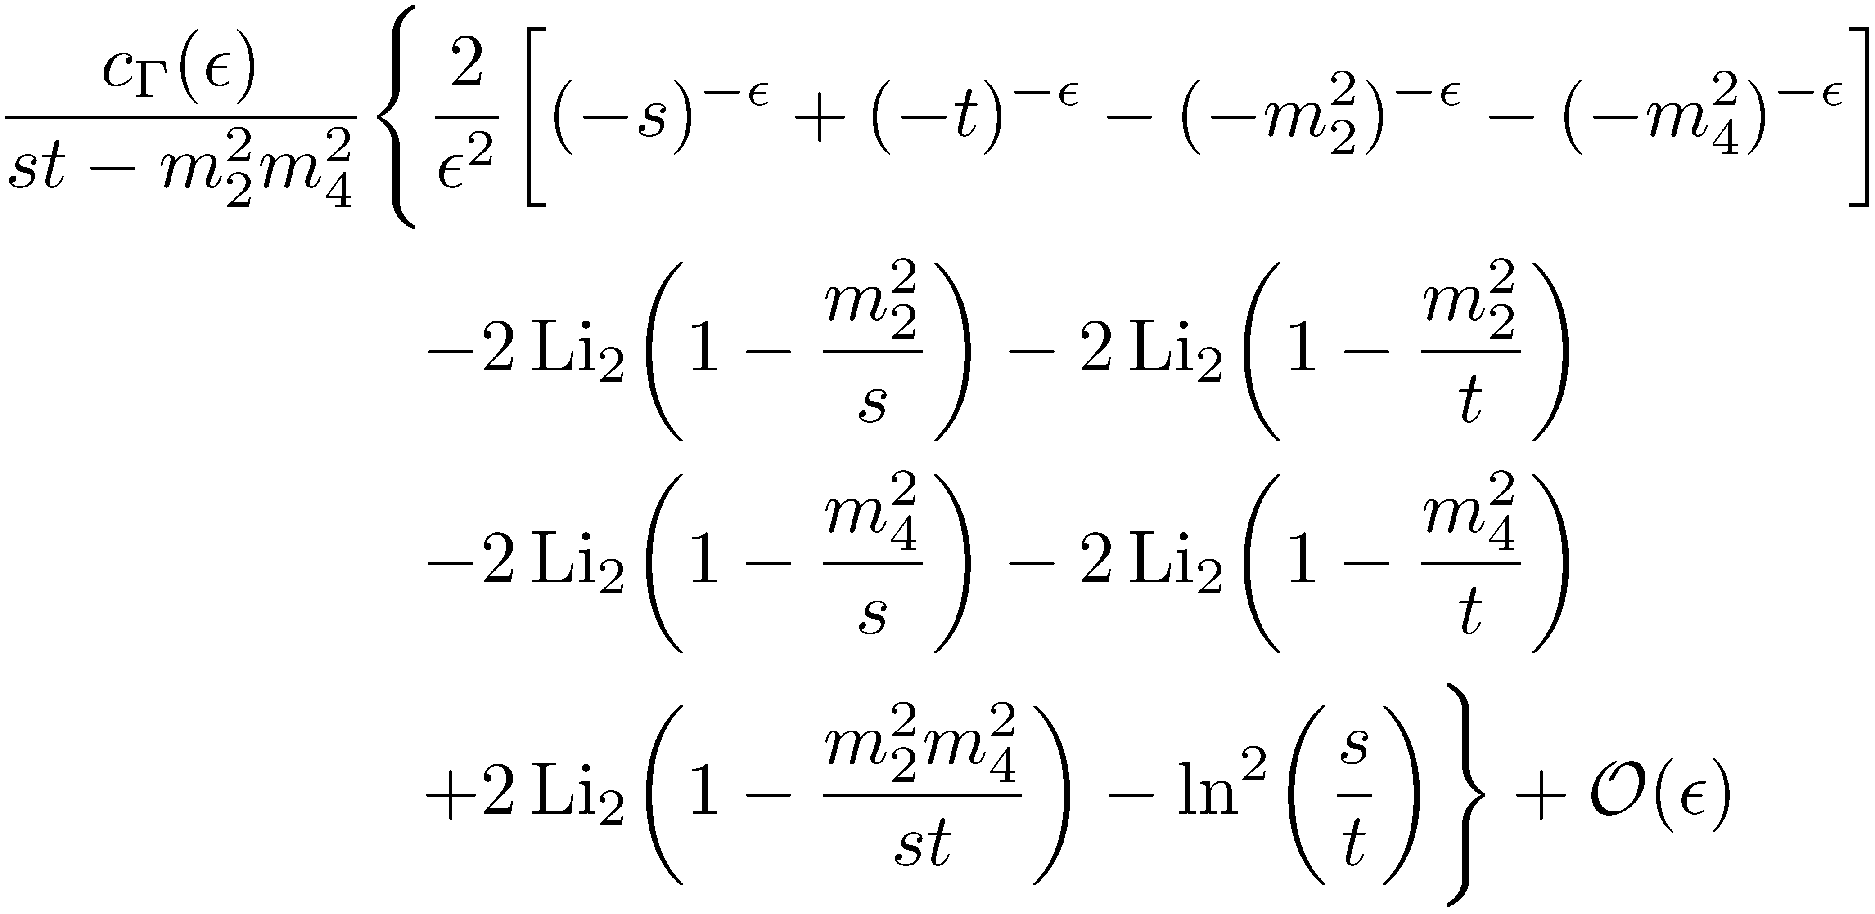
The Easy Two-Mass Box
Divergent when $ε→0$

Slide 46
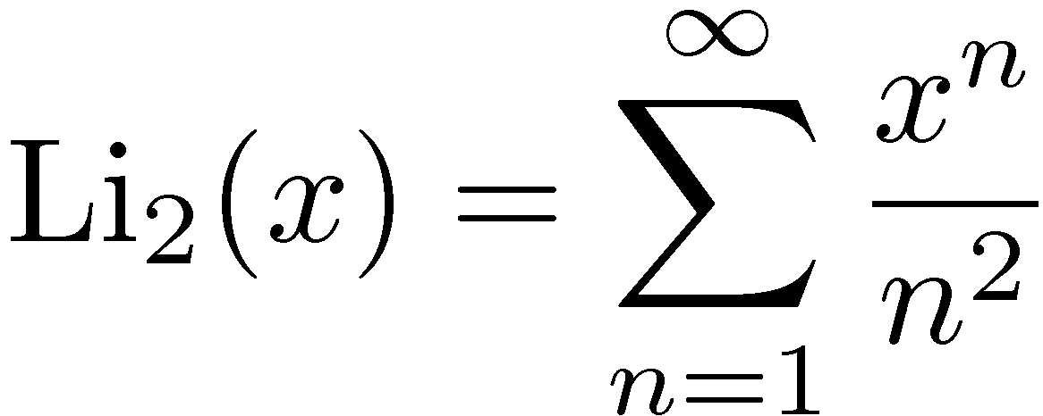
Transcendentality
Also called ‘polylog weight’
N = 4 SUSY has maximal transcendentality = 2 × loop order
QCD has mixed transcendentality: from 0 to maximal

Slide 47
Easy Two-Mass Box: Spurious Singularities

Slide 48
Cancellation of Infrared Singularities
UV singularities disappear when you define the coupling at a physical scale instead of at ∞: “renormalization”
You cannot renormalize IR singularities: virtual contributions really are divergent
Only possible source of cancellations: real-emission contributions

Slide 49
Real-Emission Singularities
Matrix element
Integrate

Slide 50
Infrared Cancellations
Cannot distinguish collinear gluons from a lone gluon: both appear as a single jet
Must introduce a physical resolution, and sum over all initial and final states within that resolution
Kinoshita–Lee–Nauenberg theorem guarantees finiteness
In collider physics, jet resolution (“cone” size and minimum $E_{T}$

Slide 51
Infrared & Collinear Safety
Physical quantities are finite
Depend on resolution parameter
Only holds for suitable (“infrared-safe”) observables in perturbation theory
Need to require that O_{n+1} → O_{n} when
two gluons or a quark anti-quark pair become collinear
a gluon becomes soft

Slide 52
Examples of infrared-safe observables
Jet cross sections measured with the (anti-)k_{T} algorithm
p_{T}-differential lepton inclusive cross section
Examples of flagrantly infrared-unsafe observables
Charged-multiplicity distribution
Completely isolated photon cross section
Examples of more subtly infrared-unsafe observables
Z p_{T} distribution at p_{T} = 0
CDF JETCLU and D0 midpoint jet algorithms

Slide 53
Cancellation of Infrared Singularities
In physical quantities accessible to perturbation theory, they cancel between real-emission contributions and virtual contributions
Quantities which are “infrared-sensitive” (e.g. charged-track multiplicity) cannot be predicted in perturbation theory, will be sensitive to long-distance (non-perturbative) physics

Slide 54
Cancellation of Infrared Singularities
How does this work in practice?
Want
Can only happen if the singular pieces of both are proportional to the same quantity
The only candidate is the basic tree-level matrix element
Almost magically, this turns out to be true!

