Slide 1
On-Shell Methods in Quantum Field Theory
David A. Kosower
Institut de Physique Théorique, CEA–Saclay
LHC PhenoNet Summer School
Cracow, Poland
September 7–12, 2013

Slide 2
Tools for Computing Amplitudes
New tools for computing in gauge theories — the core of the Standard Model
Motivations and connections
  Particle physics: SU(3) × SU(2) × U(1)
  N = 4 supersymmetric gauge theories and AdS/CFT
  Witten’s twistor string
  Grassmanians
  N = 8 supergravity

Slide 3
The particle content of the Standard Model is now complete, with last year’s discovery of a Higgs-like boson by the ATLAS and CMS collaborations
Every discovery opens new doors, and raises new questions
How Standard-Model-like is the new boson?
  We’ll need precision calculations to see
Is there anything else hiding in the LHC data?
  We’ll need background calculations to know

Slide 4
Campbell, Huston & Stirling ‘06

Slide 5
Jets are Ubiquitous

Slide 6
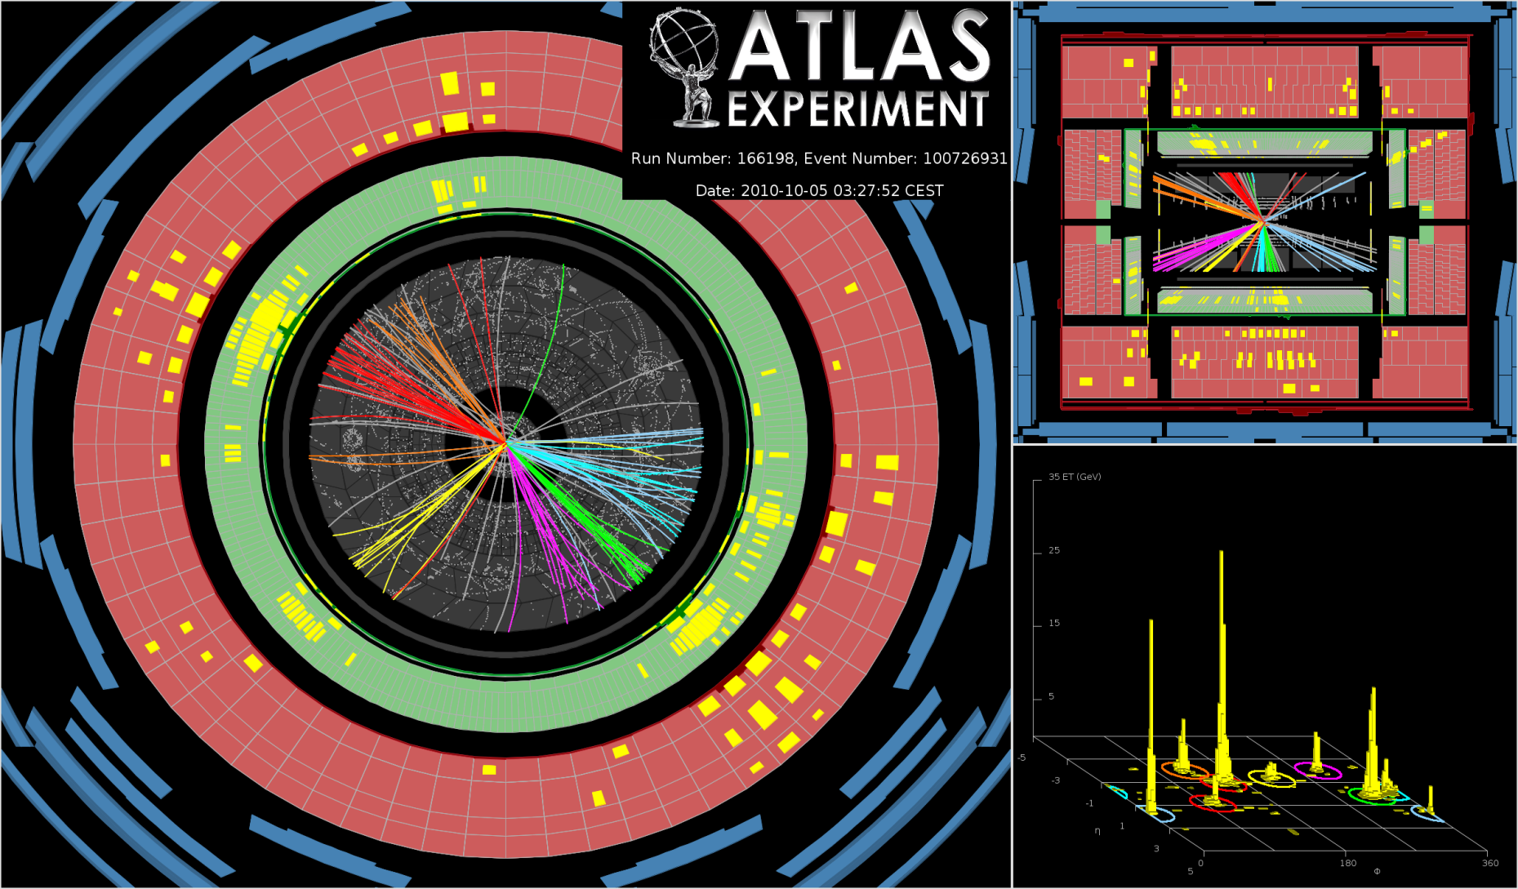
An Eight-Jet Event

Slide 7
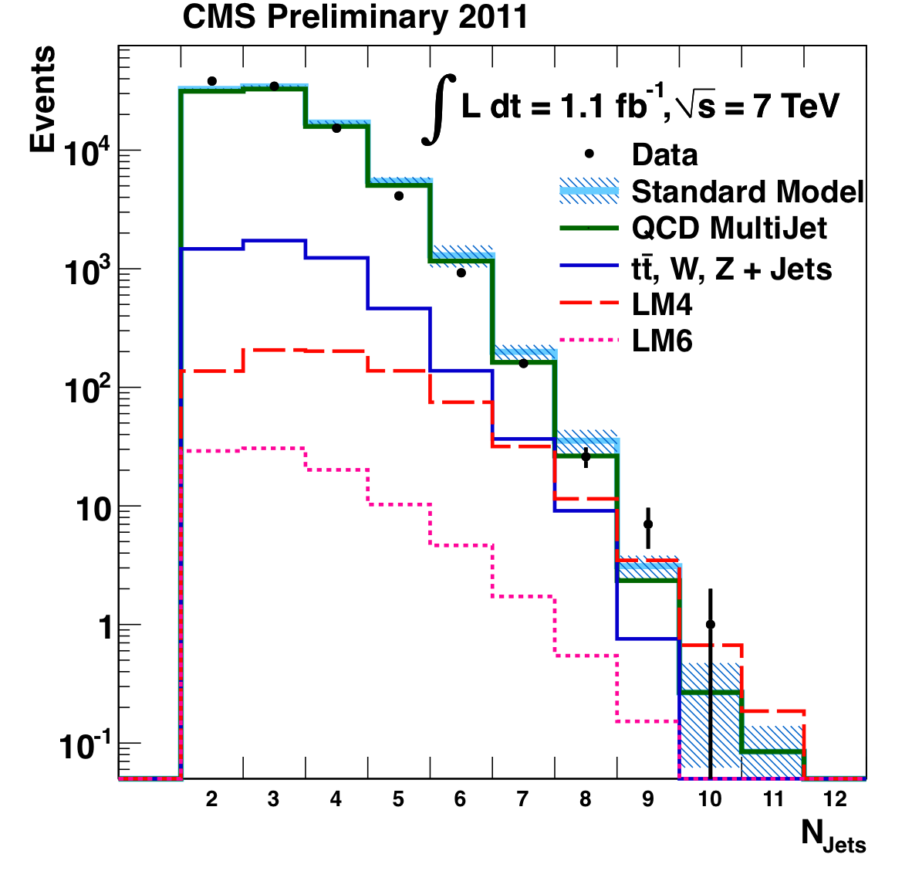
Jets are Ubiquitous

Slide 8
Complexity is due to QCD
Perturbative QCD:
Gluons & quarks → gluons & quarks
Real world:
Hadrons → hadrons with hard physics described by pQCD
Hadrons → jets narrow nearly collimated streams of hadrons

Slide 9
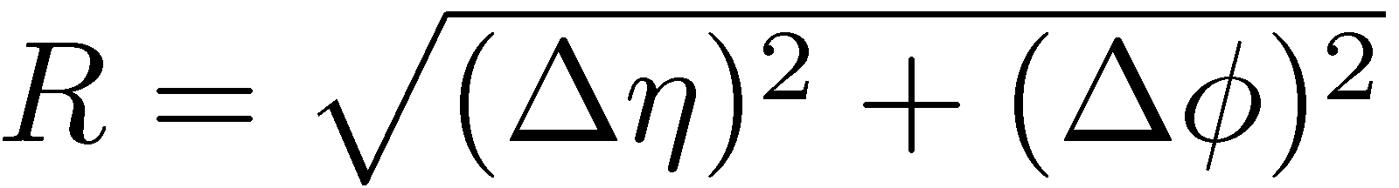
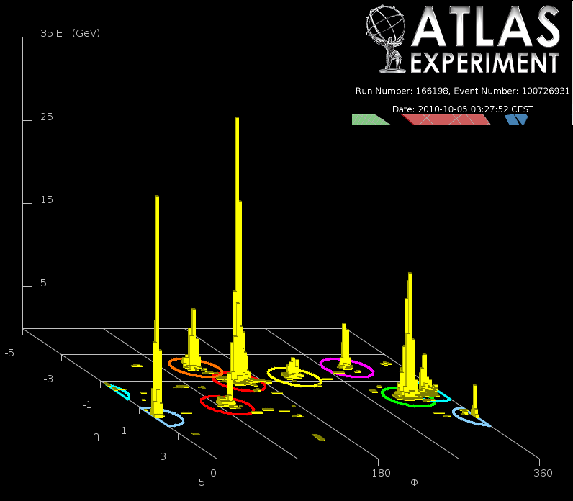
Jets
Defined by an experimental resolution parameter
  originally by invariant mass in e⁺e⁻ (JADE), later by relative transverse momentum (Durham, Cambridge, …)
  cone algorithm in hadron colliders: cone size
  and minimum E_{T}: modern version is seedless (SISCone, Salam & Soyez)
  (anti-)k_{T} algorithm: essentially by a relative transverse momentum
Atlas eight-jet event

Slide 11
In theory, theory and practice are the same.
In practice, they are different
— Yogi Berra

Slide 12
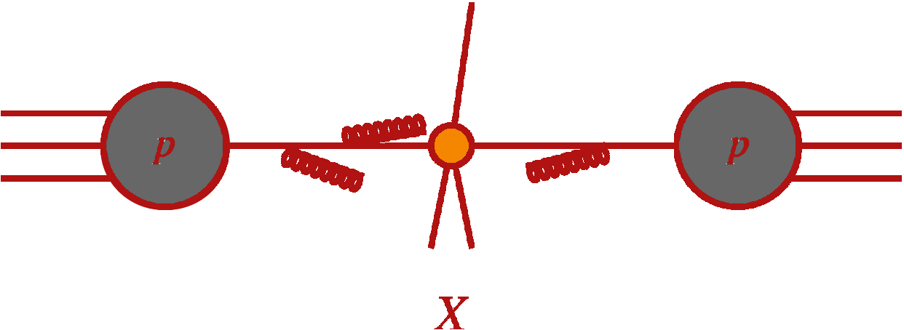
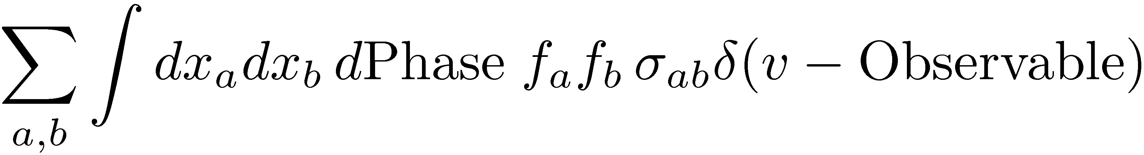
QCD-Improved Parton Model
Notes:
Figure from Del Duca’s talk at Queen Mary

Slide 13
The Challenge
Everything at a hadron collider (signals, backgrounds, luminosity measurement) involves QCD
Strong coupling is not small: α_{s}(M_{Z}) ≈ 0.12 and running is important
  events have high multiplicity of hard clusters (jets)
  each jet has a high multiplicity of hadrons
  higher-order perturbative corrections are important
Processes can involve multiple scales: p_{T}(W) & M_{W}
  need resummation of logarithms
Confinement introduces further issues of mapping partons to hadrons, but for suitably-averaged quantities (infrared-safe) avoiding small E scales, this is not a problem (power corrections)

Slide 14
Approaches
General parton-level fixed-order calculations
  Numerical jet programs: general observables
  Systematic to higher order/high multiplicity in perturbation theory
  Parton-level, approximate jet algorithm; match detector events only statistically
Parton showers ⇒ Peter Skands’s lectures
  General observables
  Leading- or next-to-leading logs only, approximate for higher order/high multiplicity
  Can hadronize & look at detector response event-by-event
  Understood how to match to matrix elements at leading order
Semi-analytic calculations/resummations
  Specific observable, for high-value targets
  Checks on general fixed-order calculations

Slide 15
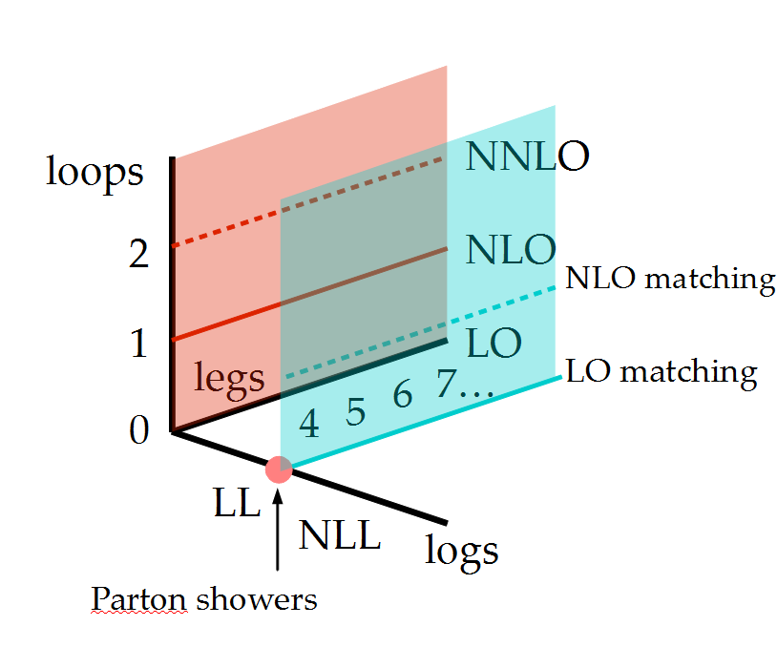
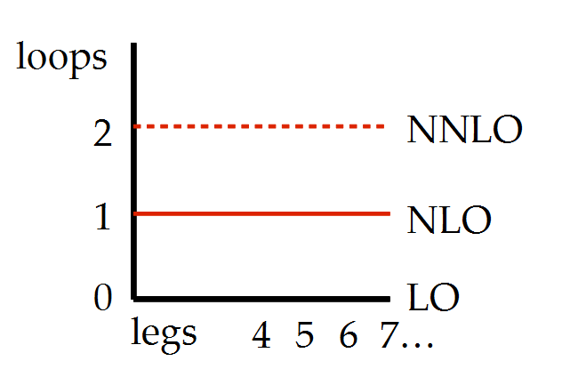
Schematically

Slide 16
Precision Perturbative QCD
Predictions of signals, signals+jets
Predictions of backgrounds
Measurement of luminosity
Measurement of fundamental parameters (α_{s}, m_{t})
Measurement of electroweak parameters
Extraction of parton distributions — ingredients in any theoretical prediction
Everything at a hadron collider involves QCD

Slide 17
Renormalization Scale
Needed to define the coupling
Physical quantities should be independent of it
Truncated perturbation theory isn’t
Dependence is ~ the first missing order * logs
Similarly for factorization scale — define parton distributions

Slide 18
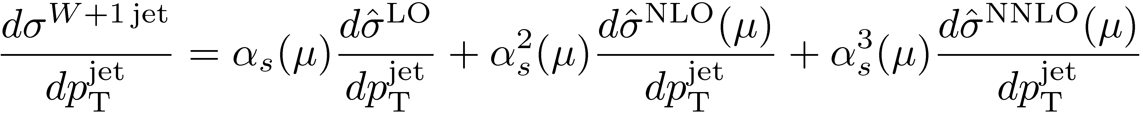
Every sensible observable has an expansion in α_{s}
Examples

Slide 19
Leading-Order, Next-to-Leading Order
QCD at LO is not quantitative
LO: Basic shapes of distributions
but: no quantitative prediction — large dependence on unphysical
renormalization and factorization scales
missing sensitivity to jet structure & energy flow
NLO: First quantitative prediction, expect it to be reliable to 10–15%
improved scale dependence — inclusion of virtual corrections
basic approximation to jet structure — jet = 2 partons
importance grows with increasing number of jets
NNLO: Precision predictions
small scale dependence
better correspondence to experimental jet algorithms
understanding of theoretical uncertainties
will be required for <5% predictions for future precision
measurements

Slide 20
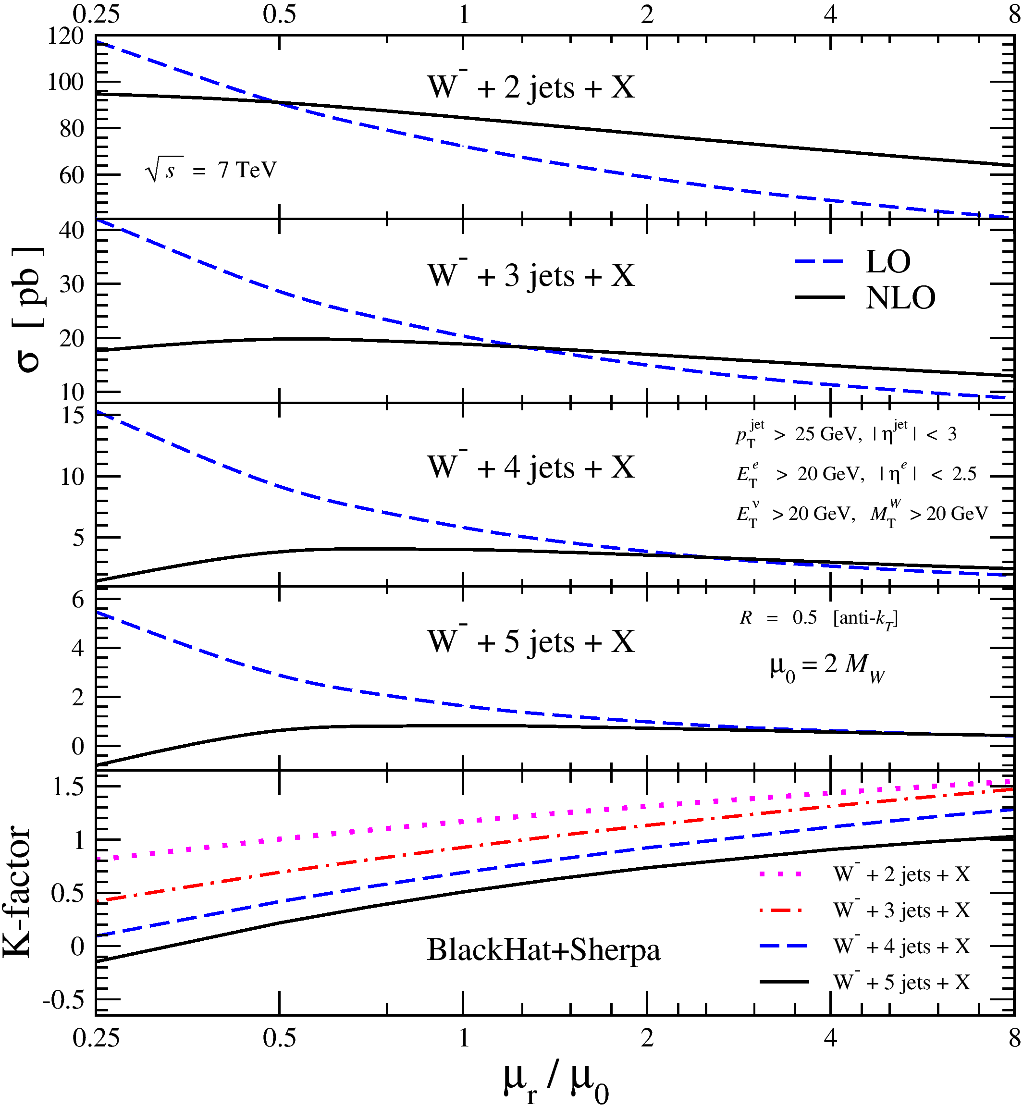

Slide 21

What Contributions Do We Need?
Short-distance matrix elements to 2-jet production at leading order: tree level amplitudes

Slide 22


Short-distance matrix elements to 2-jet production at next-to-leading order: tree level + one-loop amplitudes +
real emission
2

Slide 23
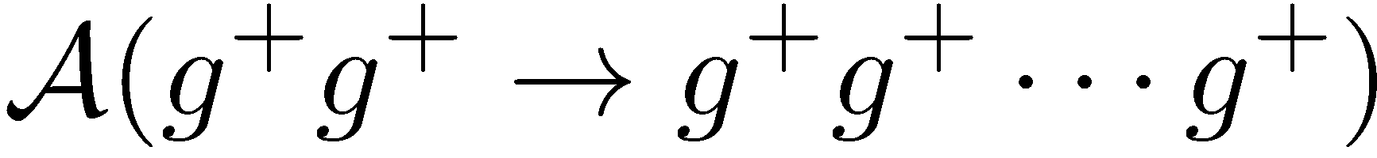
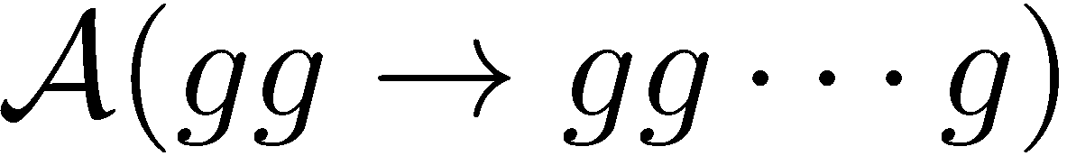
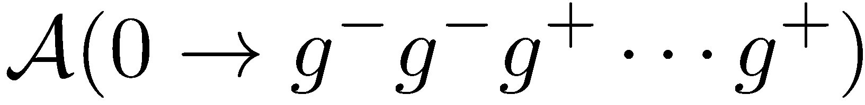
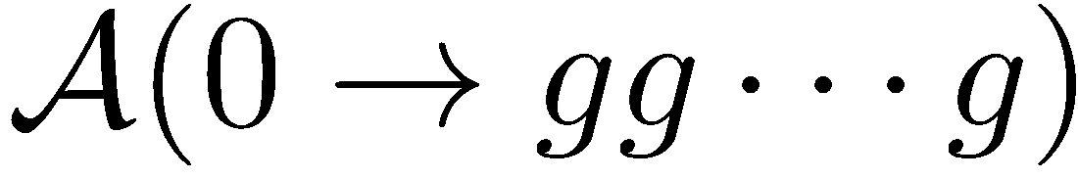
Amplitudes
Basic building blocks for computing scattering cross sections
Using crossing
Can derive all other physical quantities in gauge theories (e.g. anomalous dimensions) from them
In gravity, they are the only physical observables
MHV

Slide 24
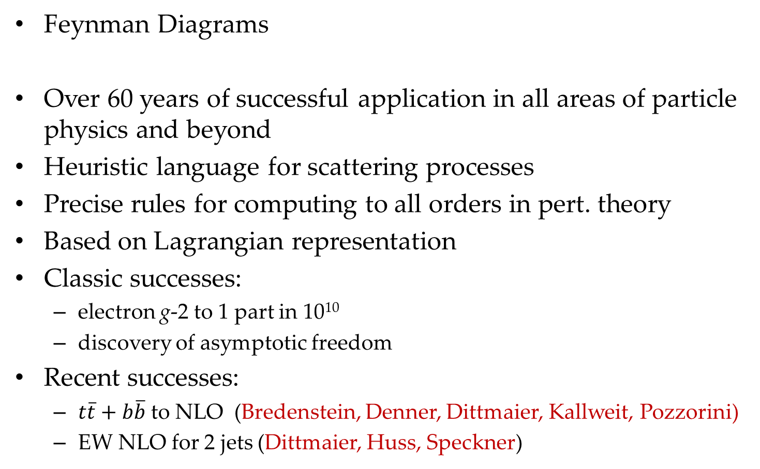
Calculating the Textbook Way
Feynman Diagrams
Over 60 years of successful application in all areas of particle physics and beyond
Heuristic language for scattering processes
Precise rules for computing to all orders in pert. theory
Based on Lagrangian representation
Classic successes:
  electron g-2 to 1 part in 10¹⁰
  discovery of asymptotic freedom
Recent successes:
  $t\overline{t}+b\overline{b}$ to NLO (Bredenstein, Denner, Dittmaier, Kallweit, Pozzorini)
  EW NLO for 2 jets (Dittmaier, Huss, Speckner)

Slide 25

Traditional Approach
Pick a process
Grab a graduate student
Lock him or her in a room
Provide a copy of the relevant Feynman rules, or at least of Peskin & Schroeder’s book
Supply caffeine, a modicum of nourishment, and occasional instructions
Provide a computer, a copy of Mathematica & a C++ compiler

Slide 26

A Difficulty
Huge number of diagrams in calculations of interest — factorial growth
2 → 6 jets: 34300 tree diagrams, ~ 2.5 ∙ 10⁷ terms
~2.9 ∙ 10⁶ 1-loop diagrams, ~ 1.9 ∙ 10¹⁰ terms

Slide 27
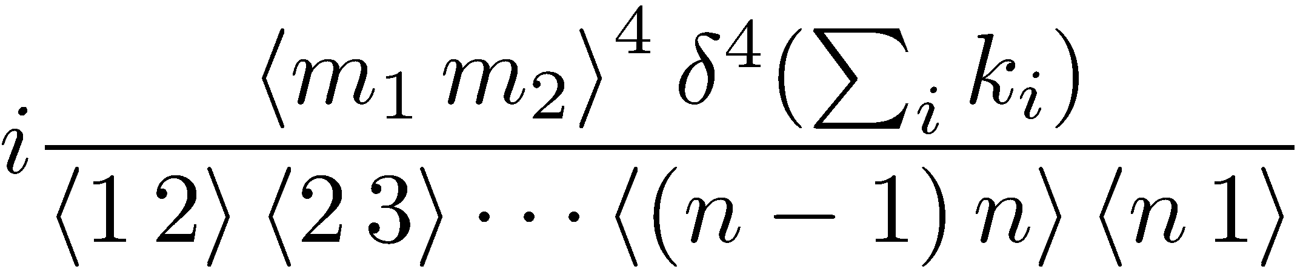

Results Are Simple!
Parke–Taylor formula for color-ordered A^{MHV}
Mangano, Parke, & Xu

Slide 28
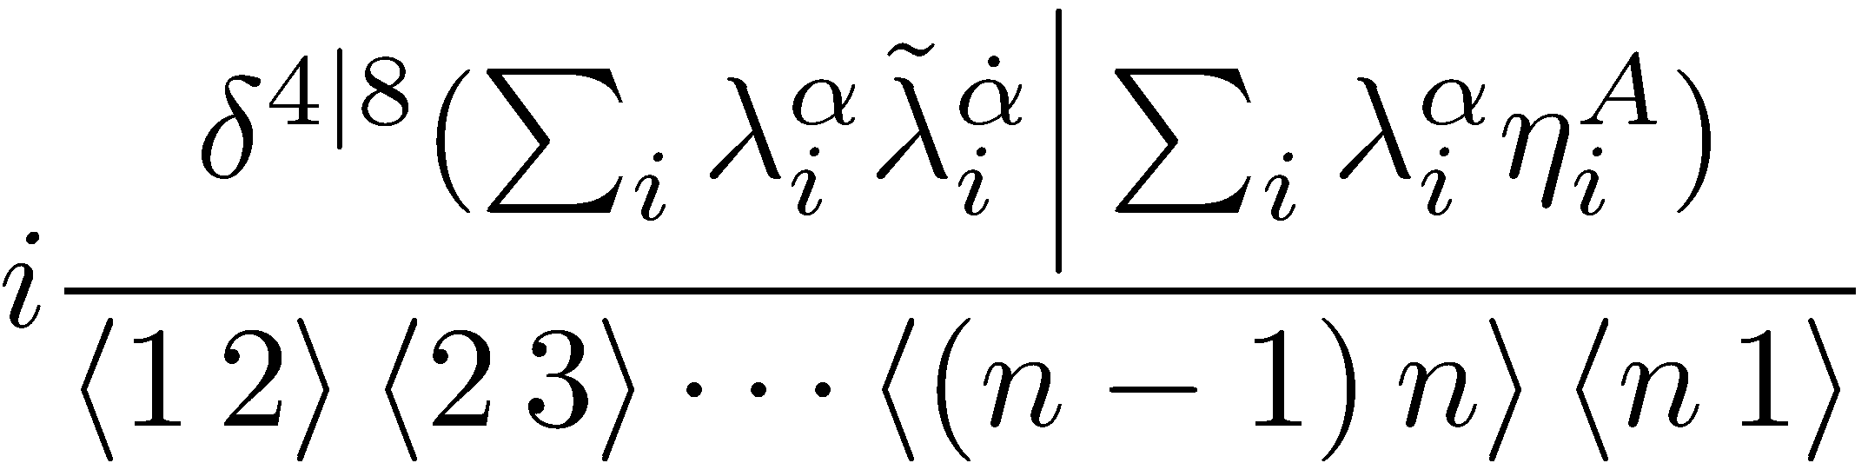
Even Simpler in N=4 Supersymmetric Theory
Nair–Parke–Taylor form for MHV-class amplitudes

Slide 29
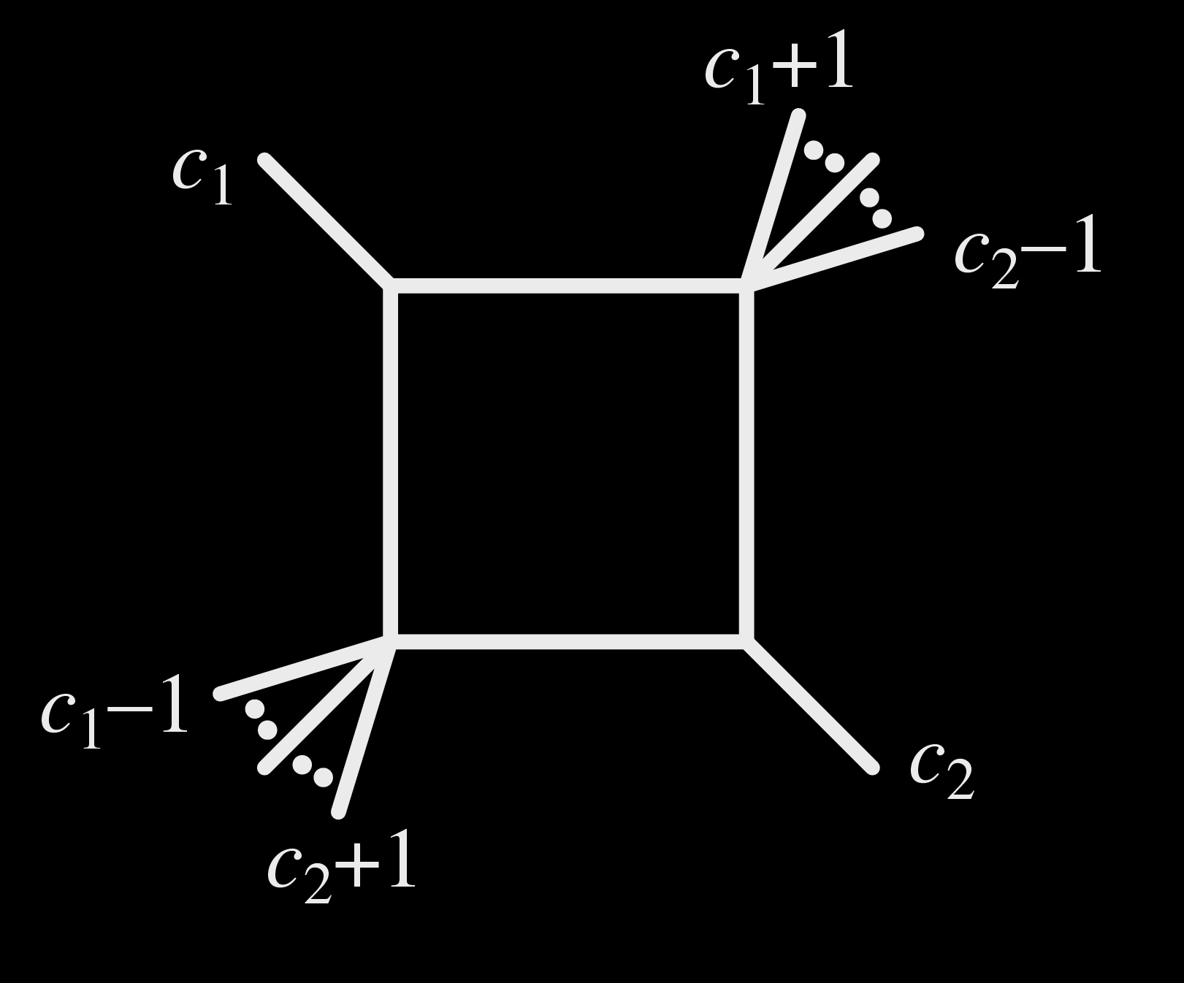
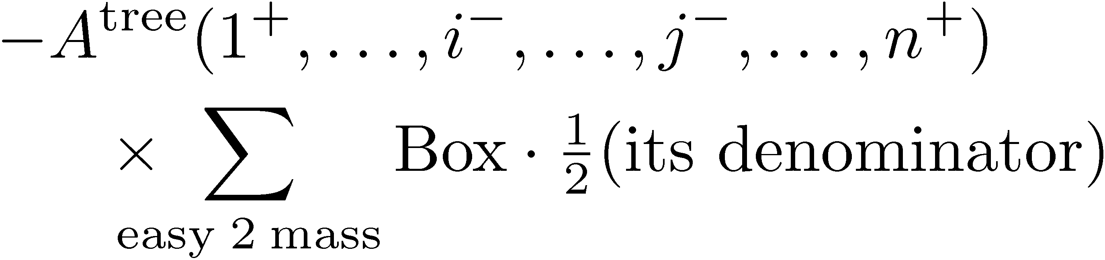
Answers Are Simple At Loop Level Too
One-loop in N = 4:
All-n QCD amplitudes for MHV configuration on a few Phys Rev D pages

Slide 30

Calculation is a Mess
Vertices and propagators involve gauge-variant off-shell states
Each diagram is not gauge-invariant — huge cancellations of gauge-noninvariant, redundant, parts are to blame (exacerbated by high-rank tensor reductions)

Slide 31
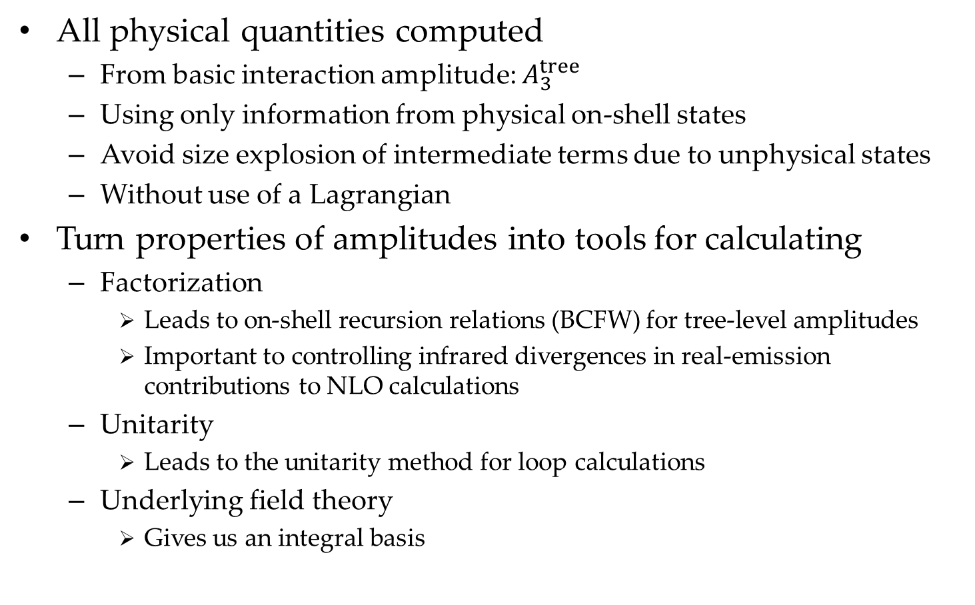
On-Shell Methods
All physical quantities computed
  From basic interaction amplitude: $A_{3}^{tree}$
  Using only information from physical on-shell states
  Avoid size explosion of intermediate terms due to unphysical states
  Without use of a Lagrangian
Turn properties of amplitudes into tools for calculating
  Factorization
    Leads to on-shell recursion relations (BCFW) for tree-level amplitudes
    Important to controlling infrared divergences in real-emission contributions to NLO calculations
  Unitarity
    Leads to the unitarity method for loop calculations
  Underlying field theory
    Gives us an integral basis

Slide 32
On-Shell Methods
Kinematics: spinor variables
Properties of amplitudes become calculational tools
Factorization → on-shell recursion
(Britto, Cachazo, Feng, Witten,…)
Unitarity → unitarity method (Bern, Dixon, Dunbar, DAK,…)
Underlying field theory → integral basis

Slide 33

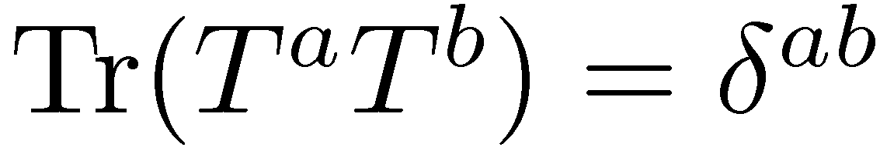

Color Decomposition
Standard Feynman rules ⇒ function of momenta, polarization vectors ε, and color indices
Color structure is predictable. Use representation
to represent each term as a product of traces,
and the Fierz identity

Slide 34

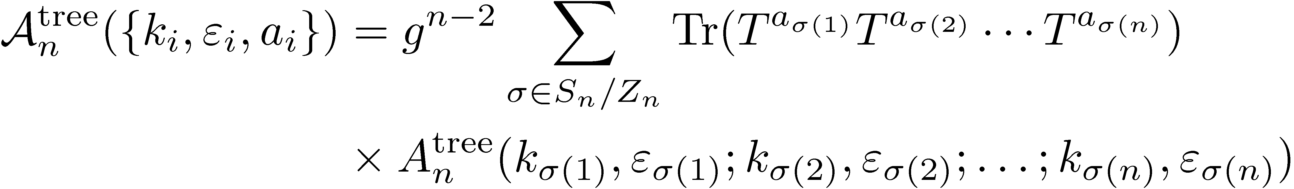
To unwind traces
Leads to tree-level representation in terms of single traces
Color-ordered amplitude — function of momenta & polarizations alone; not Bose symmetric

Slide 35

Symmetry properties
Cyclic symmetry
Reflection identity
Parity flips helicities
Decoupling equation

Slide 36

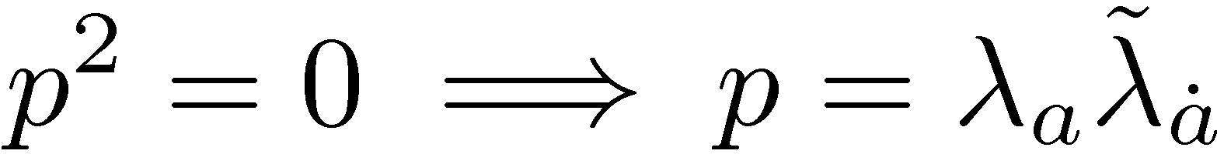
Spinor Variables
From Lorentz vectors to bi-spinors
2×2 complex matrices
with det = 1

Slide 37
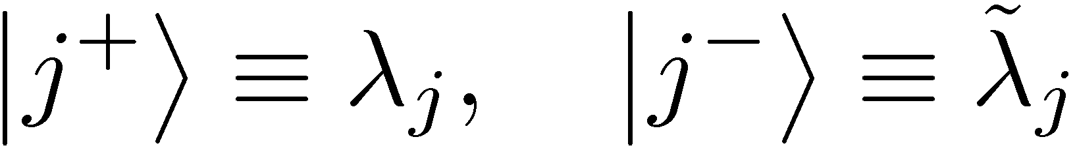
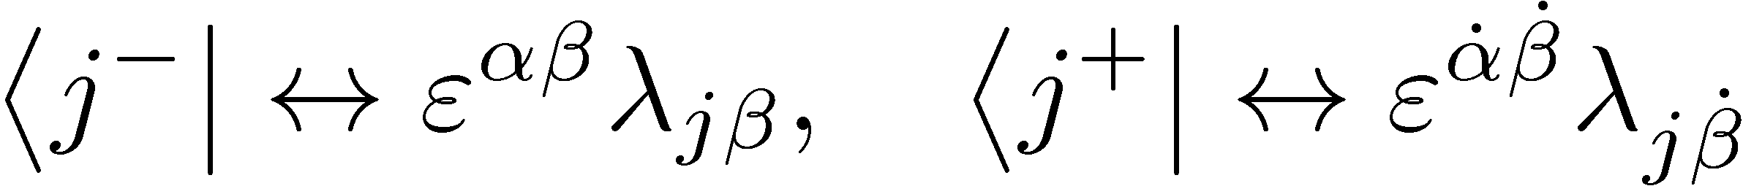
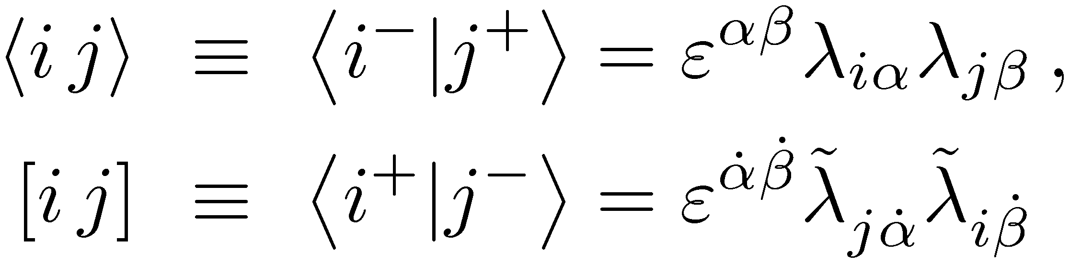
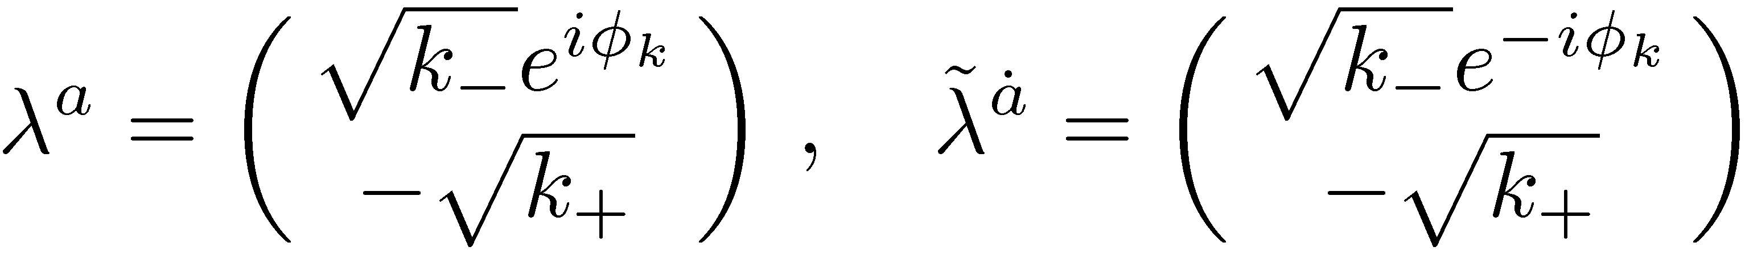

Spinor Products
Spinor variables
Introduce spinor products
Explicit representation
where

Slide 38



We then obtain the explicit formulæ
otherwise
so that the identity always holds
Notation

Slide 39
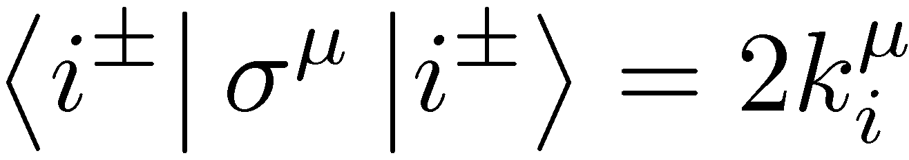
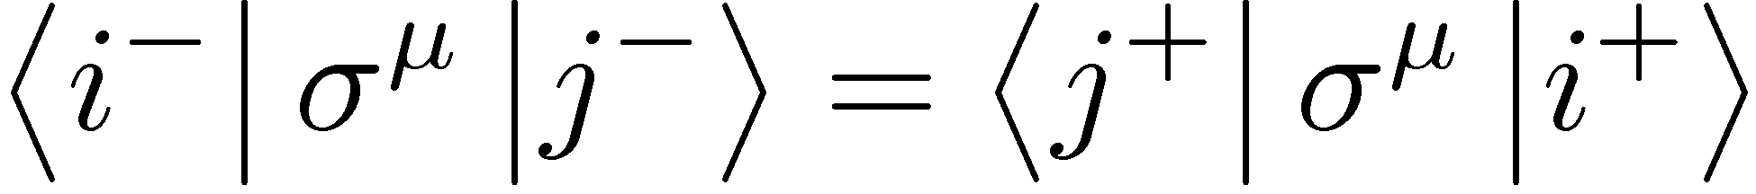

Properties of the Spinor Product
Antisymmetry
Gordon identity
Charge conjugation
Fierz identity
Projector representation
Schouten identity

Slide 40
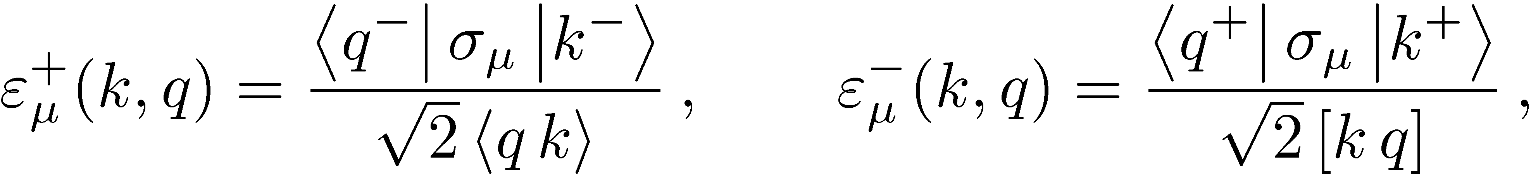


Spinor Helicity
Gauge bosons also have only ± physical polarizations
Elegant — and covariant — generalization of circular polarization
‘Chinese Magic’
Xu, Zhang, Chang (1984)
reference momentum q
Transverse
Normalized

Slide 41
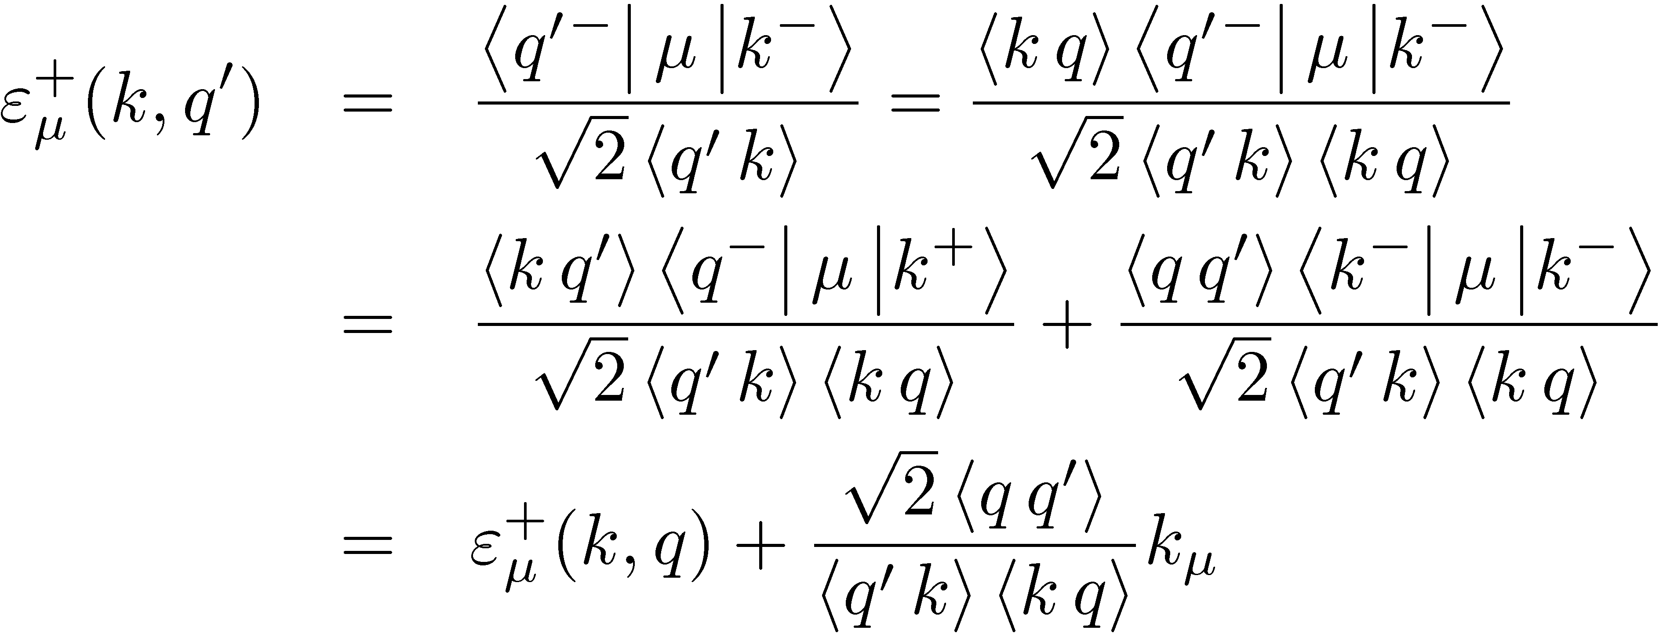
What is the significance of q?

Slide 42

Properties of the Spinor-Helicity Basis
Physical-state projector
Simplifications

Slide 43
A Mathematica Implementation: S@M
Maitre and Mastrolia (0710.5559)

Slide 44

Color-Ordered Three-Vertex

Slide 45
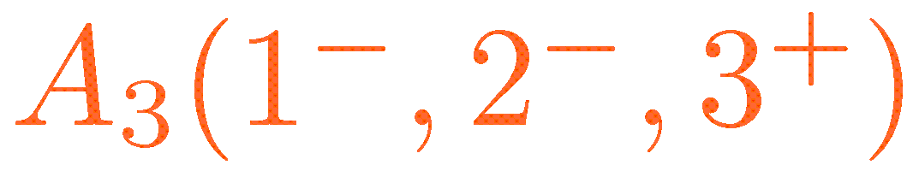
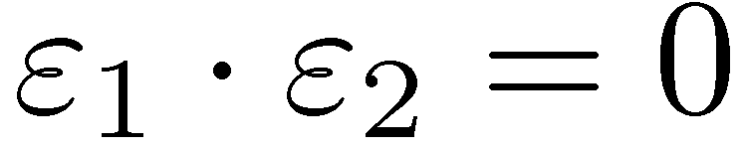
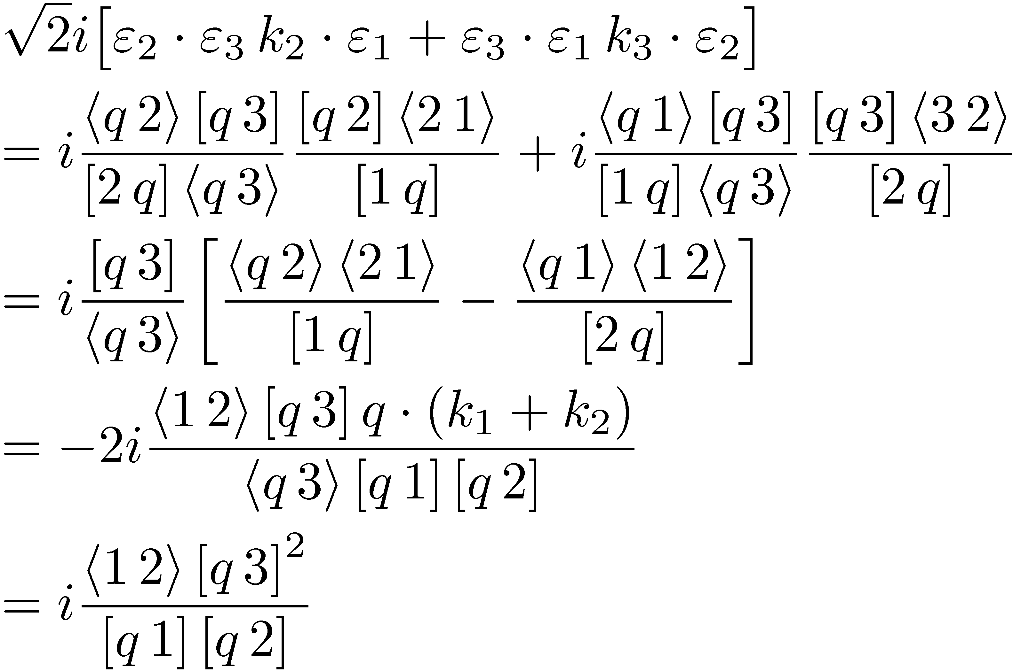
Choose common reference momentum q for all legs, so
and we have to compute

Slide 46
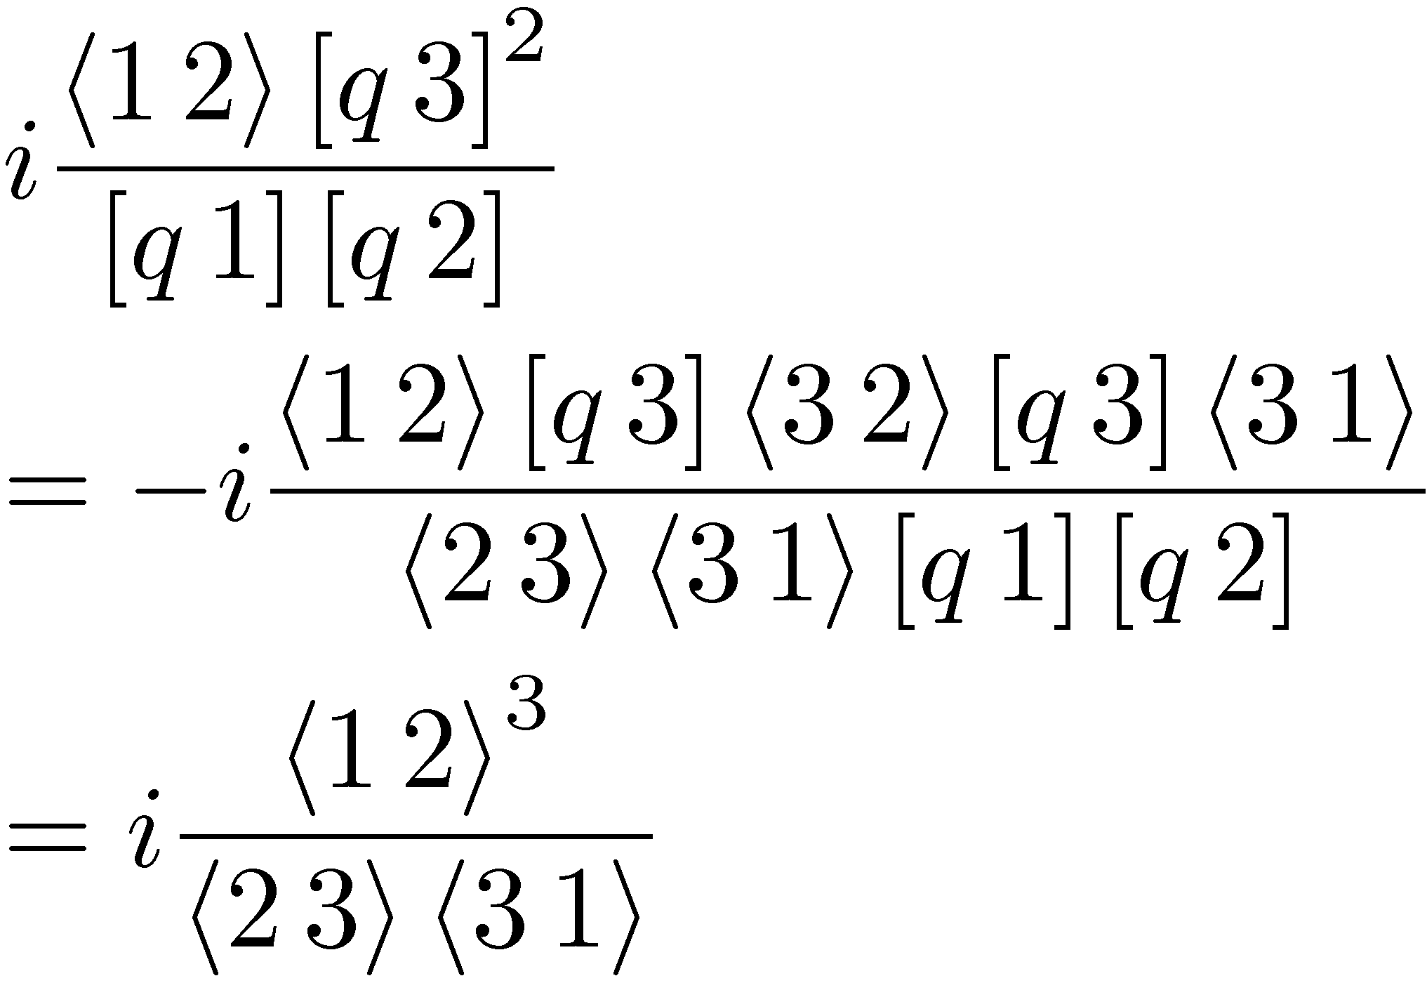
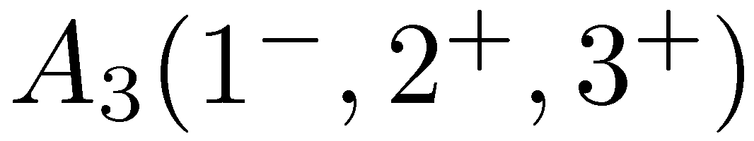
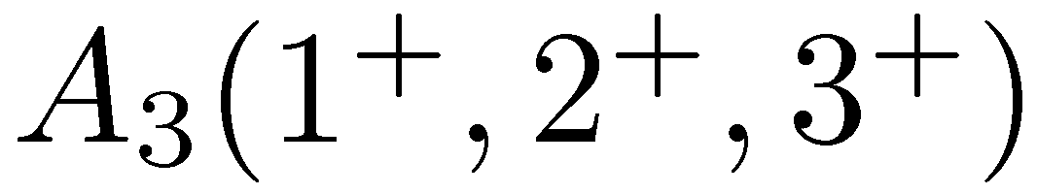
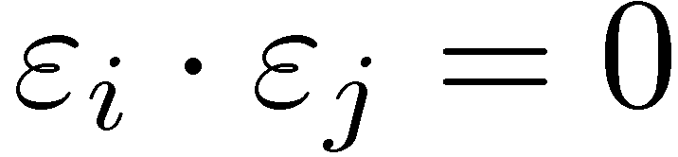
Not manifestly gauge invariant
but gauge invariant nonetheless.
is given by the spinor-conjugate formula
For , choose same reference momentum for all legs ⇒ all so amplitude vanishes

Slide 47
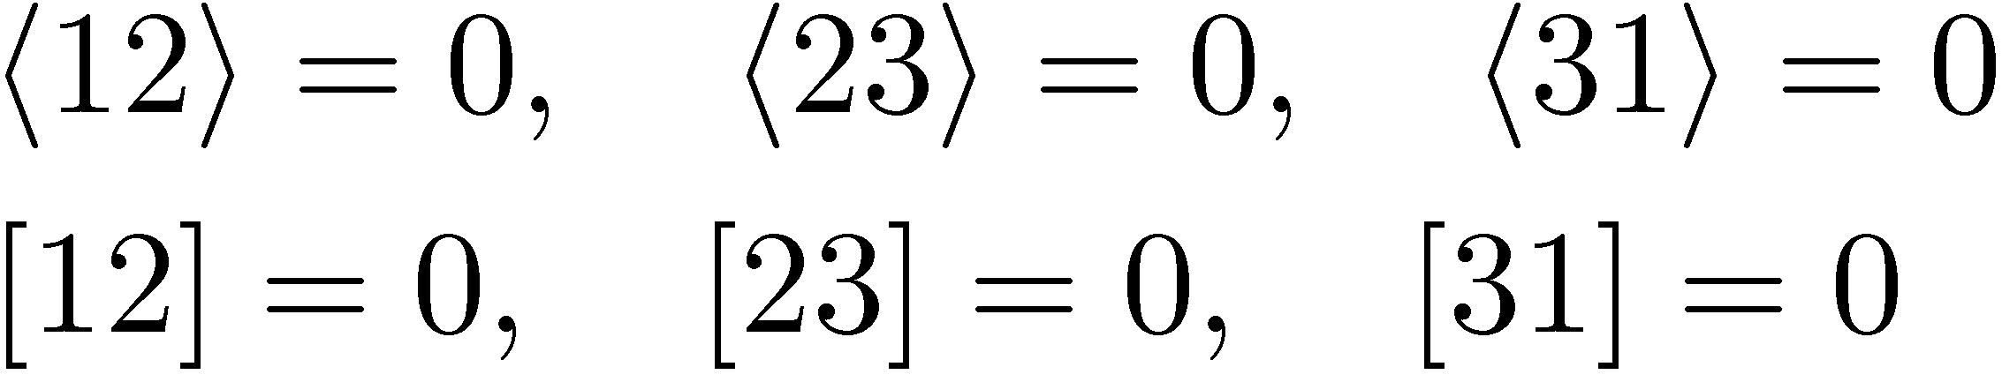
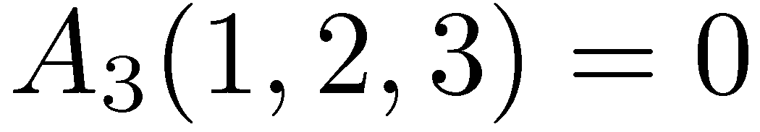
A Slight Problem
In three-particle kinematics,
so all invariants vanish,
and all spinor products vanish,
and hence the three-point amplitude vanishes
This is a Bad Thing

Slide 48


Slide 49
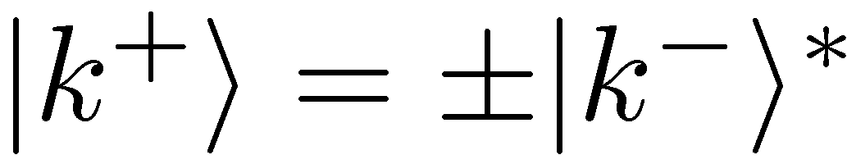
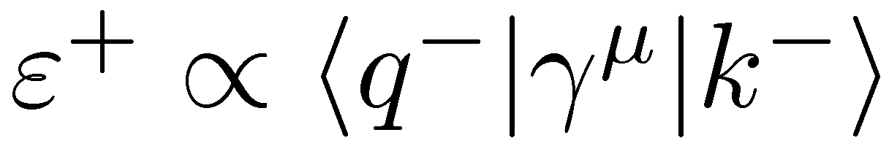
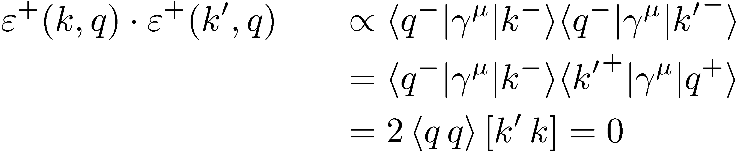
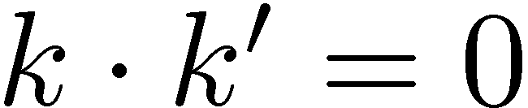
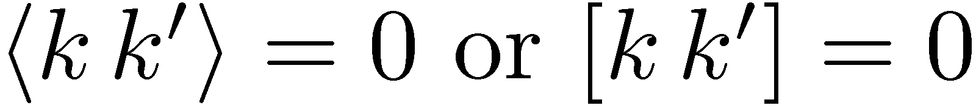
Complex Momenta to the Rescue
For real momenta,
but we can choose these two spinors independently and still have k² = 0
Recall the polarization vector:
but
Now when two momenta are collinear
only one of the spinors has to be collinear
but not necessarily both

