Slide 1
On-Shell Methods in Quantum Field Theory
David A. Kosower Institut de Physique Théorique, CEA–Saclay
LHC PhenoNet Summer School Cracow, Poland September 7–12, 2013

Slide 2
Review of Lecture I
Introduced spinor variables
and spinor products
Obtained simple formulæ for three-point on-shell amplitudes
and shifted to thinking in terms of complex momenta so that we can have $〈12〉≠0$ while $\left[12\right]=0$ and vice versa

Slide 3
Three-Point Amplitudes Without a Lagrangian
Non-trivial three-point amplitude at tree level is a rational function of $\{\left.〈12〉,〈23〉,〈31〉\right\}$ or $\{\left.\left[12\right],\left[23\right],[31]\right\}$
Helicity operator for particle i (summed over a)
What is its value on a physical state?

Slide 4
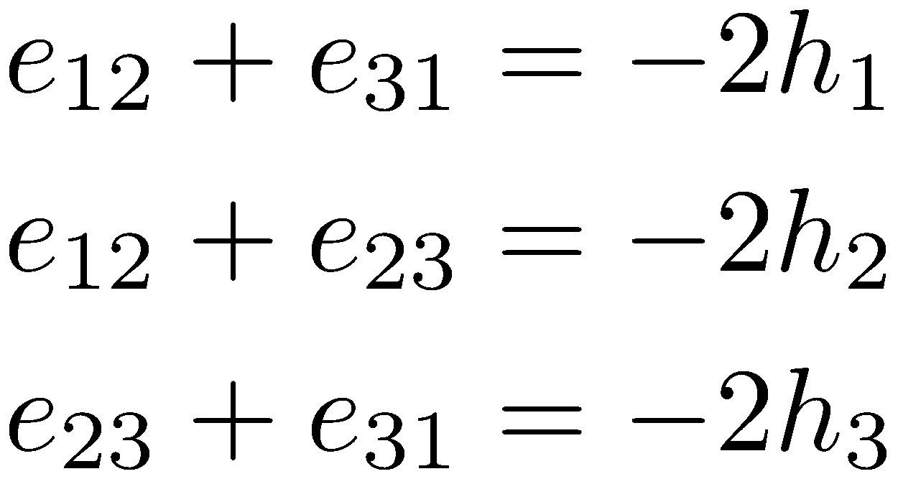
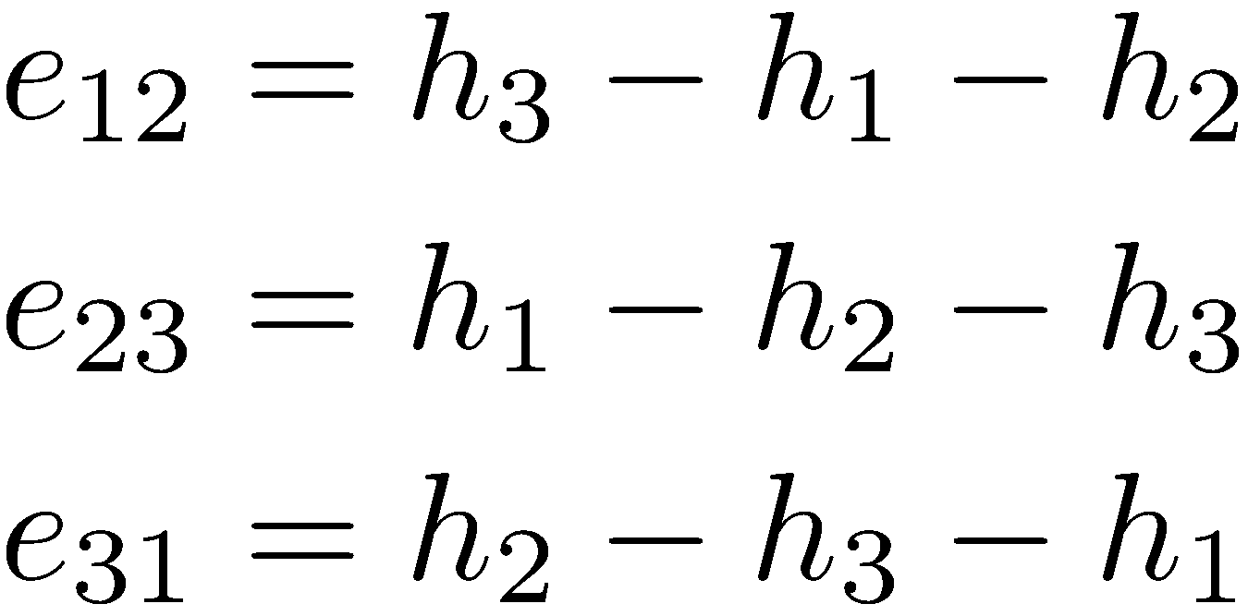
Must act same way on three-point amplitude
Suppose
Then we have the three equations
or

Slide 5
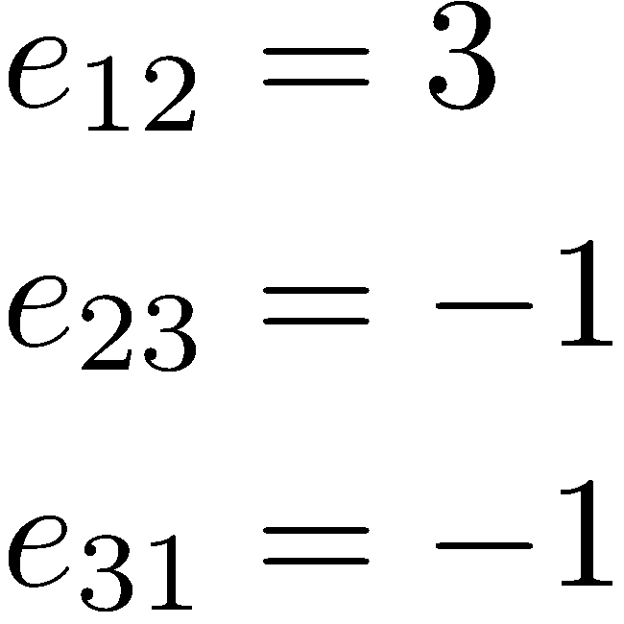
Plug in $h_{i}$:
or

Slide 6
For more external legs, we can write down a few simple helicity amplitudes:
Parke-Taylor equations
Mangano, Xu, Parke (1986)
Maximally helicity-violating or ‘MHV’
Originally proven using the Berends–Giele recurrence relations (1988)

Slide 7
Color Decomposition
With spinors in hand, we can rewrite our color decomposition formula

Slide 8
On-Shell Methods
Kinematics: spinor variables
Properties of amplitudes become calculational tools
Factorization → on-shell recursion
(Britto, Cachazo, Feng, Witten,…)
Unitarity → unitarity method (Bern, Dixon, Dunbar, DAK,…)
Underlying field theory → integral basis

Slide 9
Factorization Properties of Amplitudes
As sums of external momenta approach poles,
amplitudes factorize
More generally as

Slide 10
Factorization in Gauge Theories
Tree level
As but
Sum over helicities of intermediate leg
In massless theories beyond tree level, the situation is more complicated but at tree level it works in a standard way

Slide 11
What Happens in the Two-Particle Case?
With real momenta, as we’ve already seen,
In gauge theories, factorization holds (at tree level) for n ≥ 3 but breaks down for n = 2: A₃ = 0 so we get 0/0
However A₃ only vanishes linearly, so the amplitude is not finite in this limit, but should ~ 1/k, that is 1/$\sqrt{s_{12}}$
For complex momenta, behaves no differently than general case

Slide 12
This is a collinear limit
Combine amplitude with propagator to get a non-vanishing object

Slide 13
Two-Particle Case
Collinear limit: splitting amplitude

Slide 14
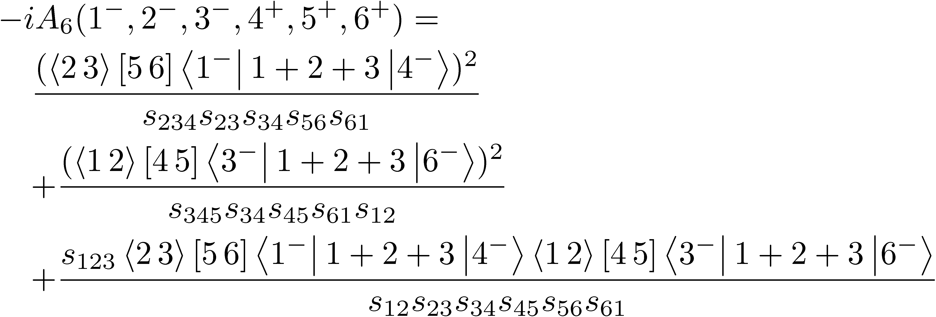
Example: Three-Particle Factorization
Consider

Slide 15
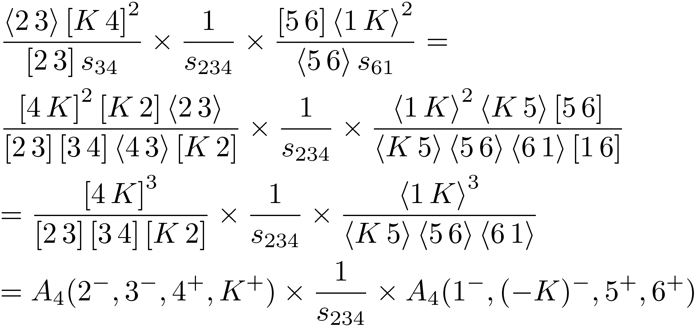
As $s_{123}→0$, it’s finite: expected because
As $s_{234}→0$, pick up the first term; with $K=k_{2}+k_{3}+k_{4}$

Slide 16
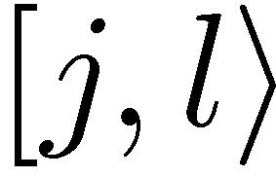
BCFW On-Shell Recursion Relations
Britto, Cachazo, Feng, Witten (2005)
Define a shift of spinors by a complex parameter z
which induces a shift of the external momenta
and defines a z-dependent continuation of the amplitude $A(z)$
Assume that $A\left(z\right)→0$ as $z→∞$

Slide 17
Momenta are still on shell
Momentum is still conserved

Slide 18
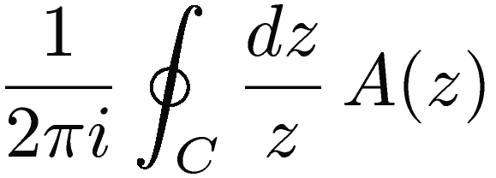
A Contour Integral
Consider the contour integral
Determine A(0) in terms of other residues

Slide 19
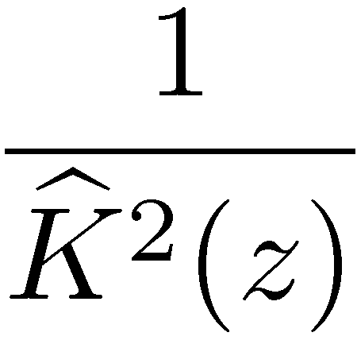
Using Factorization
Other poles in z come from zeros of z-shifted propagator denominators
Splits diagram into two parts with z-dependent momentum flow

Slide 20
Exactly factorization limit of z-dependent amplitude
poles from zeros of
That is, a pole at
Residue
Notation $\hat{k}=k(z_{ab})$

Slide 21
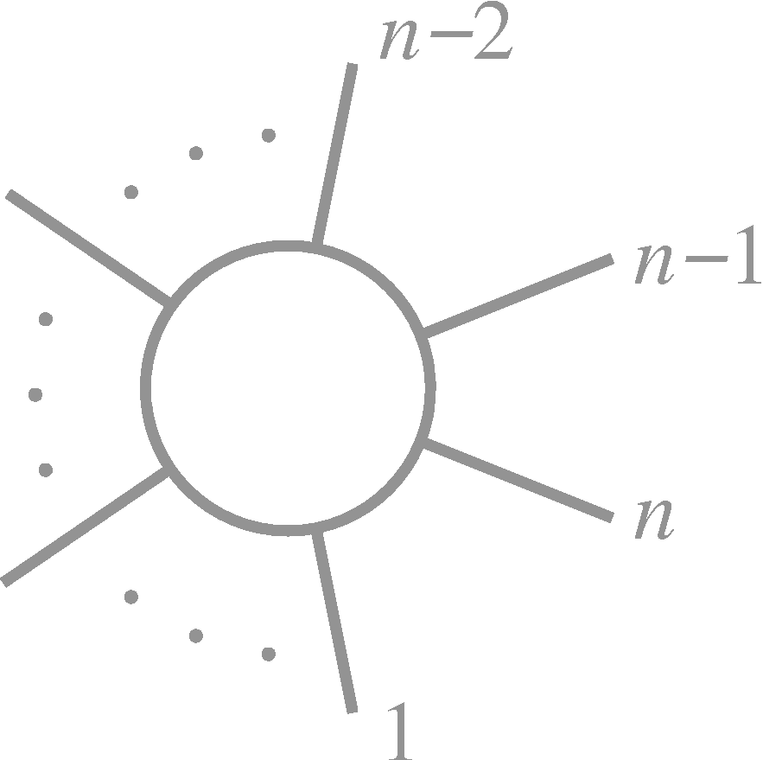
On-Shell Recursion Relation
=

Slide 22
Partition P: two or more cyclicly-consecutive momenta containing j, such that complementary set contains l,
The recursion relations are then
On shell

Slide 23
Number of terms ~ |l−j| × (n−3)
so best to choose l and j nearby
Complexity still exponential, because shift changes as we descend the recursion

Slide 24
Applications
Very general: relies only on complex analysis + factorization
Applied to gravity
Bedford, Brandhuber, Spence, & Travaglini (2/2005); Cachazo & Svrček (2/2005)
Massive amplitudes
Badger, Glover, Khoze, Svrček (4/2005, 7/2005); Forde & DAK (7/2005)
Other rational functions
Bern, Bjerrum-Bohr, Dunbar, & Ita (7/2005)
Connection to Cachazo–Svrček–Witten construction
Risager (8/2005)
CSW construction for gravity
Bjerrum-Bohr, Dunbar, Ita, Perkins, & Risager (9/2005)
Manifestly supersymmetric forms
Brandhuber, Heslop, Travaglini; Arkani-Hamed, Cachazo, Kaplan (2008)

Slide 25
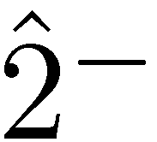
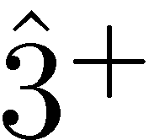
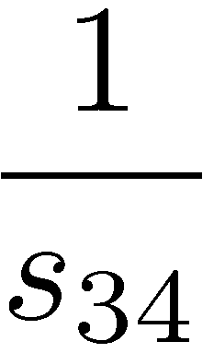
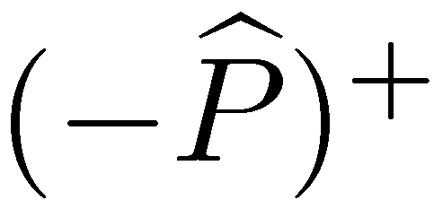
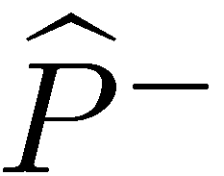
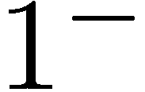
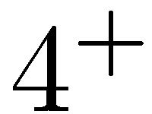
Four-Point Example
Pick a $[2,3〉$ shift, giving one diagram

Slide 26
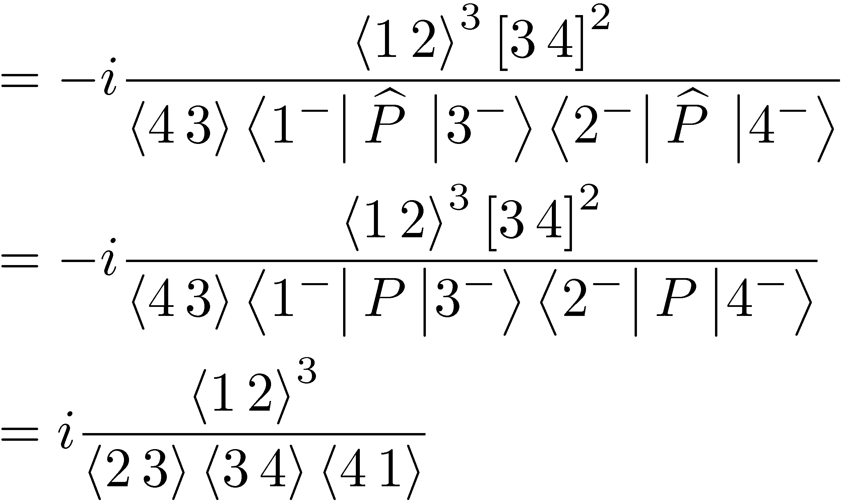

Slide 27
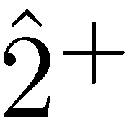
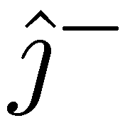
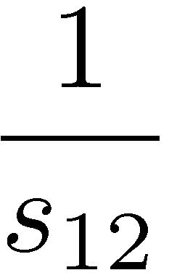
MHV Amplitudes
Compute the (1⁻,j⁻) amplitude: choose $[3,2〉$ shift
Other diagrams vanish because $A_{n}\left(+…+±\right)=0$
Or $A_{3}\left({\hat{3}}^{+},4^{+},−{\hat{P}}^{±}\right)=0$

Slide 28
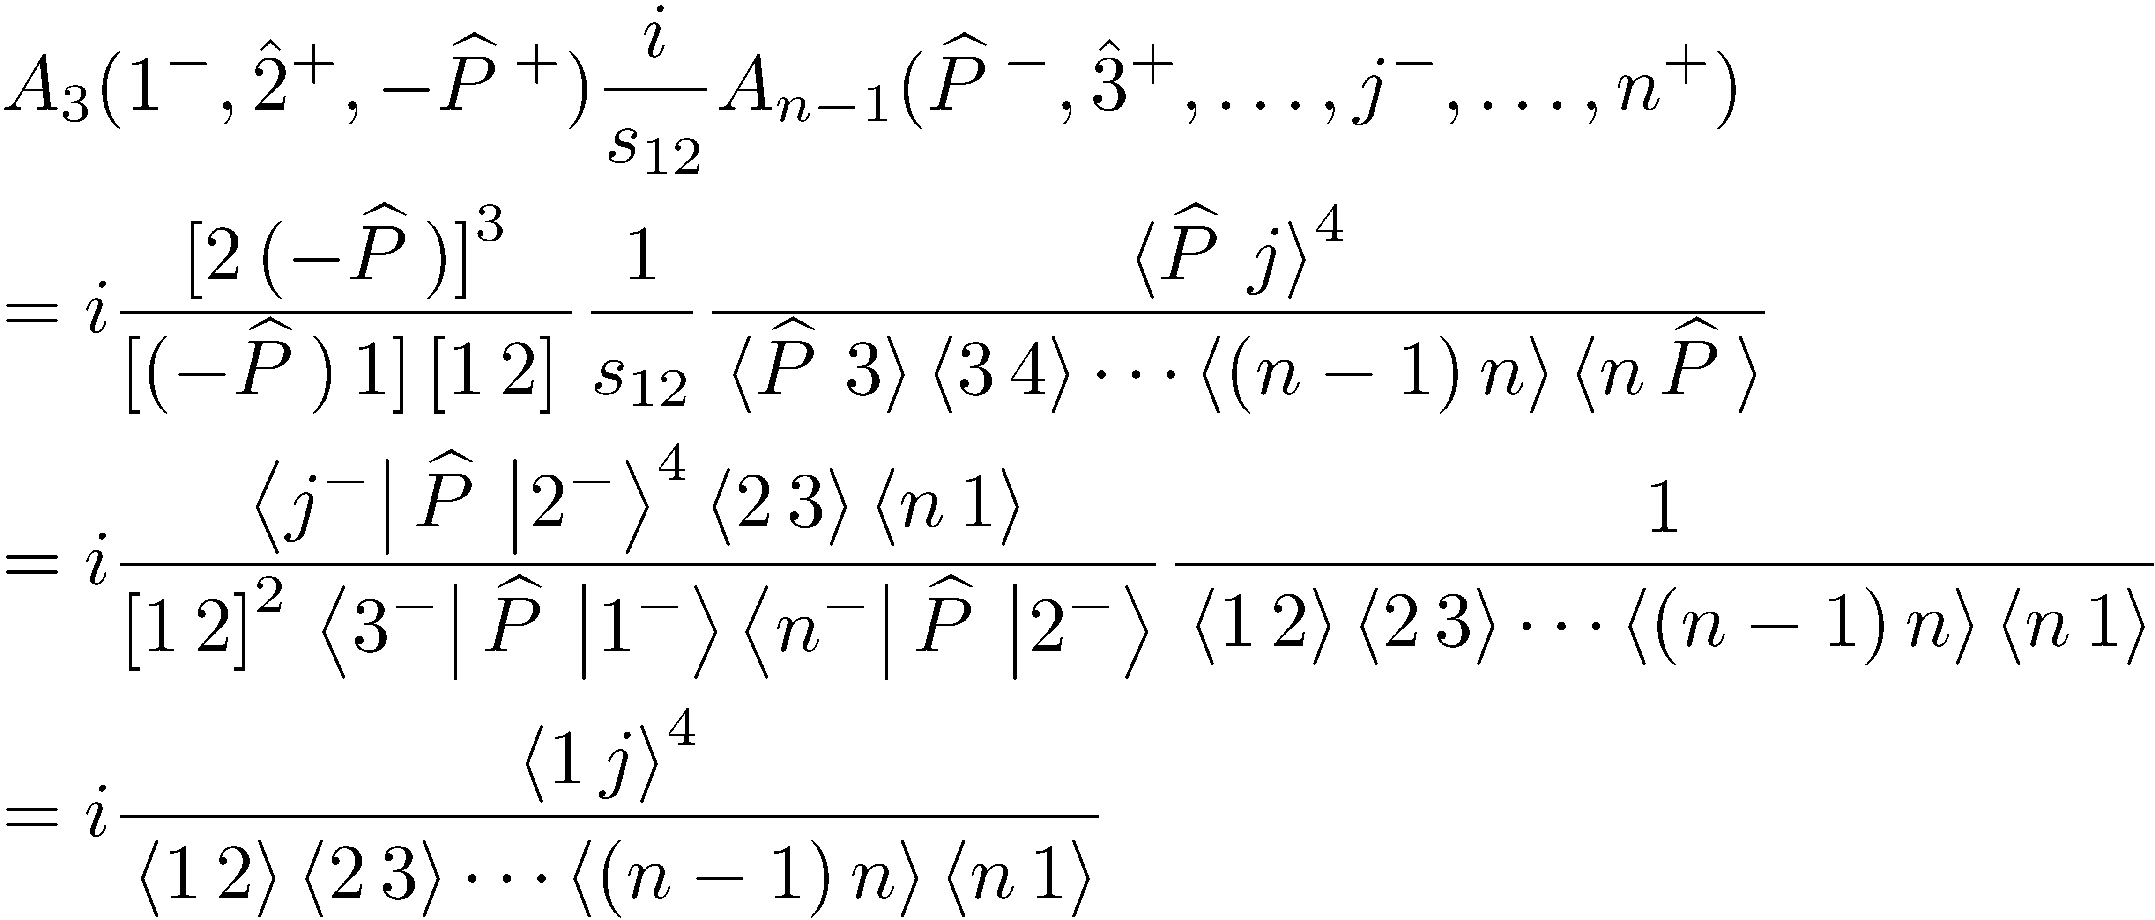
Prove Parke–Taylor equation by induction

Slide 29
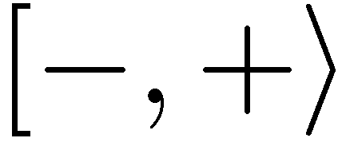
Choosing Shift Momenta
What are legitimate choices?
Need to ensure that as
At tree level, legitimate choices
Power counting argument in Feynman diagrams for

Slide 30
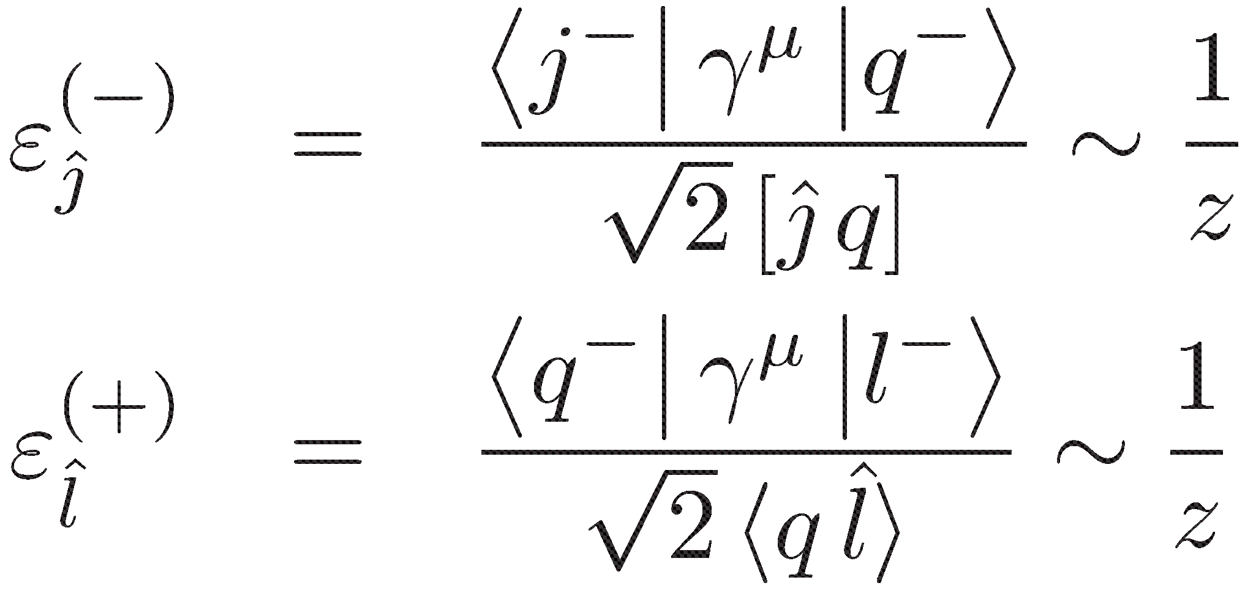
Three-point vertices with z-dependent momentum flow ~ z
Four-point vertices with z-dependent momentum flow ~ 1
Propagators with z-dependent momentum flow ~ 1/z
Leading contributions from diagrams with only three-point vertices and propagators connecting j to l: ~ 1/z
(one more vertex than propagators & two εs)

Slide 31
On-Shell Methods
Kinematics: spinor variables
Properties of amplitudes become calculational tools
Factorization → on-shell recursion (Britto, Cachazo, Feng, Witten)
Unitarity → unitarity method (Bern, Dixon, Dunbar, DAK,…)
Basic Unitarity
Generalized Unitarity
Underlying field theory → integral basis

Slide 32
Unitarity
Basic property of any quantum field theory: conservation of probability. In terms of the scattering matrix,
In terms of the transfer matrix we get,
or
with the Feynman iε

Slide 33
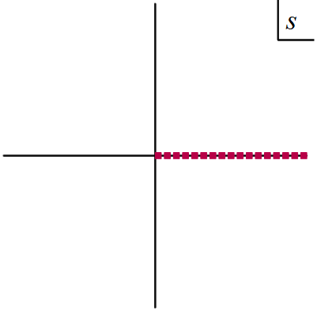
Can imagine reconstructing dispersive (real) part via dispersion relations
More generally, amplitudes are determined by their analytic structure
Version 0 of unitarity

Slide 34
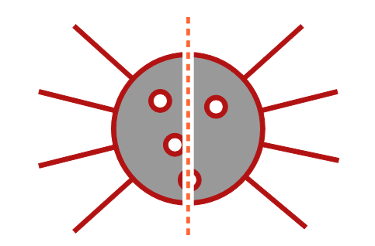
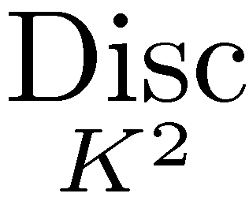
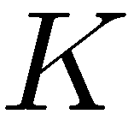
In Feynman Integrals
Cutkosky rules (1960s)
Each cut:

Slide 35
At one loop
Lorentz-invariant phase-space measure

Slide 36
Problems
Diagram-by-Diagram
Massive particles: massless particles have divergences
Absorptive (imaginary) parts only
An amplitude has many channels; here we handle only one

Slide 37
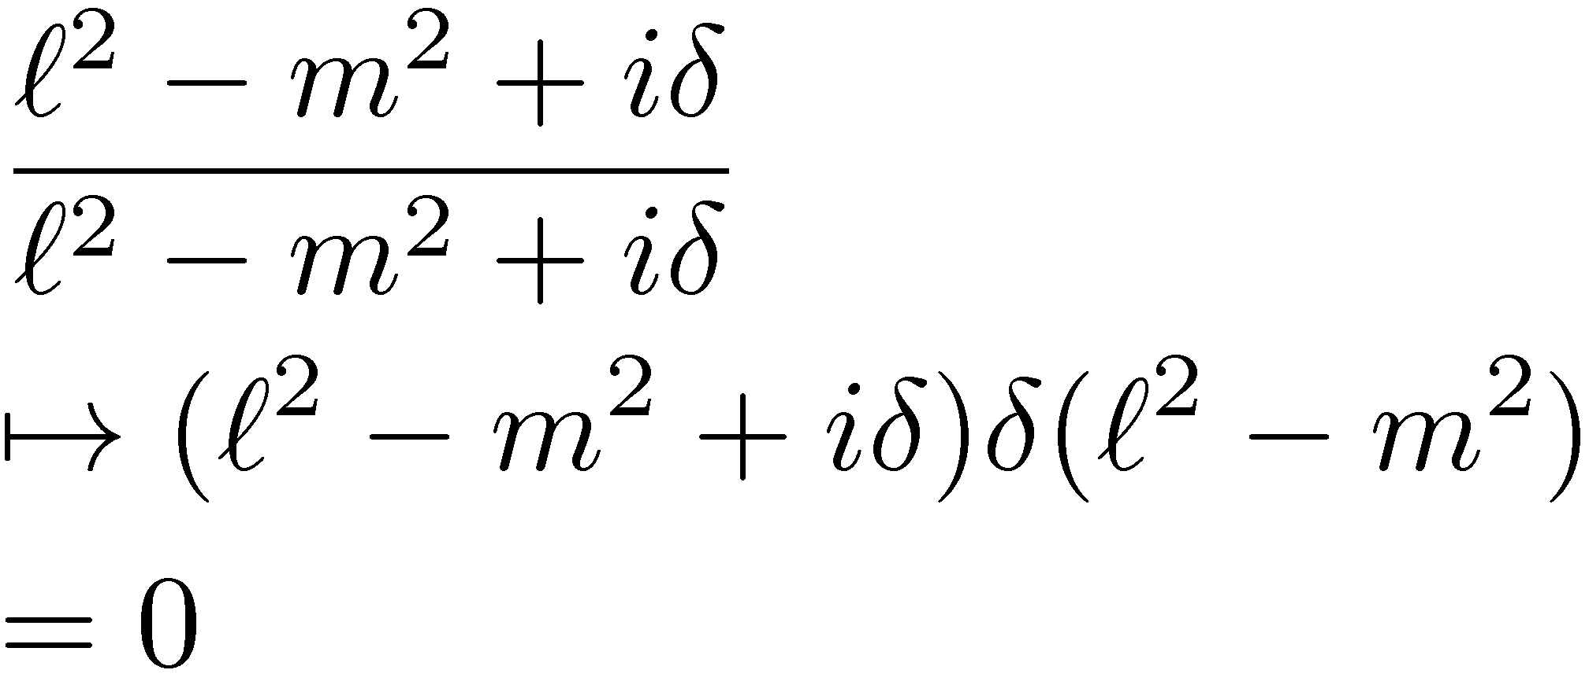
Gedanken calculation
Some diagrams are missing one or both propagators surrounding K²:
no contribution
Also fate of “off-shell” terms

Slide 39
First Steps
Compute tree amplitudes: using Berends–Giele recursion, BCFW, Grassmannians, etc.
Form phase-space integral
Promote it back to a loop integral
This has the correct cut in the K² channel, not necessarily in other channels
Do algebra to simplify numerator, and perform integral reductions

Slide 40
Problems
Diagram-by-Diagram
Massive particles: massless particles have divergences
Absorptive (imaginary) parts only
An amplitude has many channels; here we handle only one

